Slide 1
Lecture 8:
Deep Learning Software
CS231N_Study_AI_Robotics
Hanjun Kim
2019.08.05
Notes:
발표 시작 시, 가장 흥미로운 주제 중 하나이고, 매년 새로운 소프트웨어가 생겨난다고 발언함.

Slide 2
Administrative
Project proposals were due Tuesday
We are assigning TAs to projects, stay tuned
We are grading A1
A2 is due Thursday 5/4
Remember to stop your instances when not in use
Only use GPU instances for the last notebook
Lecture 8 -2
2
Notes:
당시에 Assignment 1 과 Assignment 2를 내주었는데, Project 여기서 Google Cloud 등을 사용할 때 Instance 를 꼭 종료할 것을 명시함
크레딧을 아끼라 정도

Slide 3


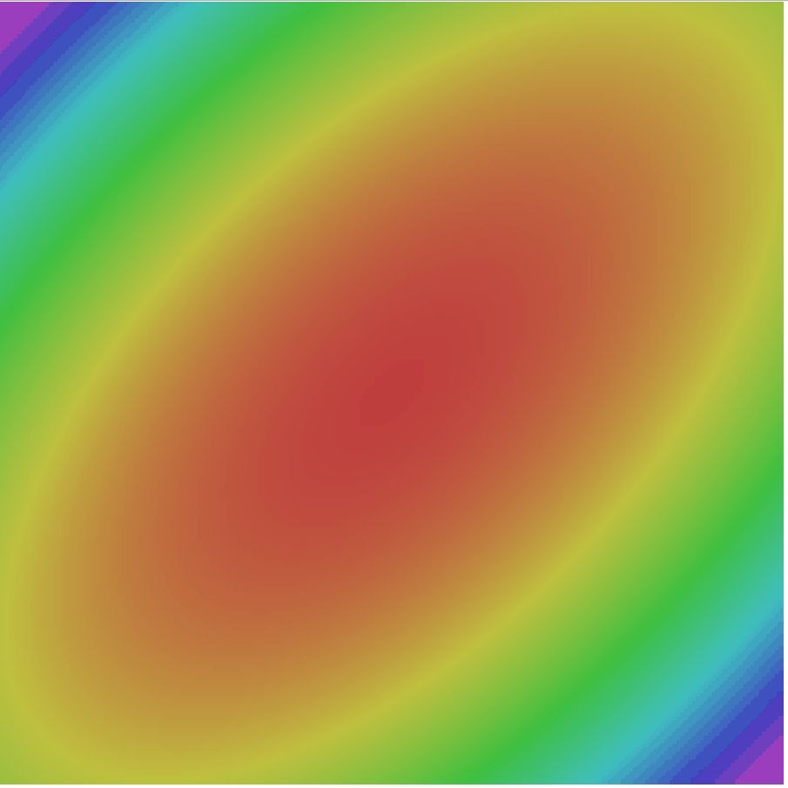



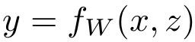
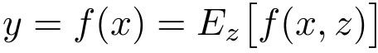
Last time
Regularization: Dropout
Transfer Learning
Optimization: SGD+Momentum, Nesterov, RMSProp, Adam
 | FC-C
 | FC-4096
 | FC-4096
Reinitialize this and train
MaxPool
Conv-512
Conv-512
MaxPool
Conv-512
Conv-512
MaxPool
Conv-256
Conv-256
Freeze these
Regularization: Add noise, then marginalize out
Train
Test
MaxPool
Conv-128
Conv-128
MaxPool
Conv-64
Conv-64
Image
Lecture 8 -
3
Notes:
Lecture 7에서 진행한 Deep Learning Model 용 Fancier optimization algorithms 설명 (SGD+momentum / Nesterov / RMSProp / Adam 등 의 기법 사용) -> 이는 Network Converge 를 좀 더 빠르게 해줌

Slide 4
Today
CPU vs GPU
Deep Learning Frameworks
Caffe / Caffe2
Theano / TensorFlow
Torch / PyTorch
Lecture 8 -4
4

Slide 5
CPU vs GPU
Lecture 8 -
5
Fei-Fei Li & Justin Johnson & Serena Yeung Lecture 8 - April 27, 2017

Slide 6
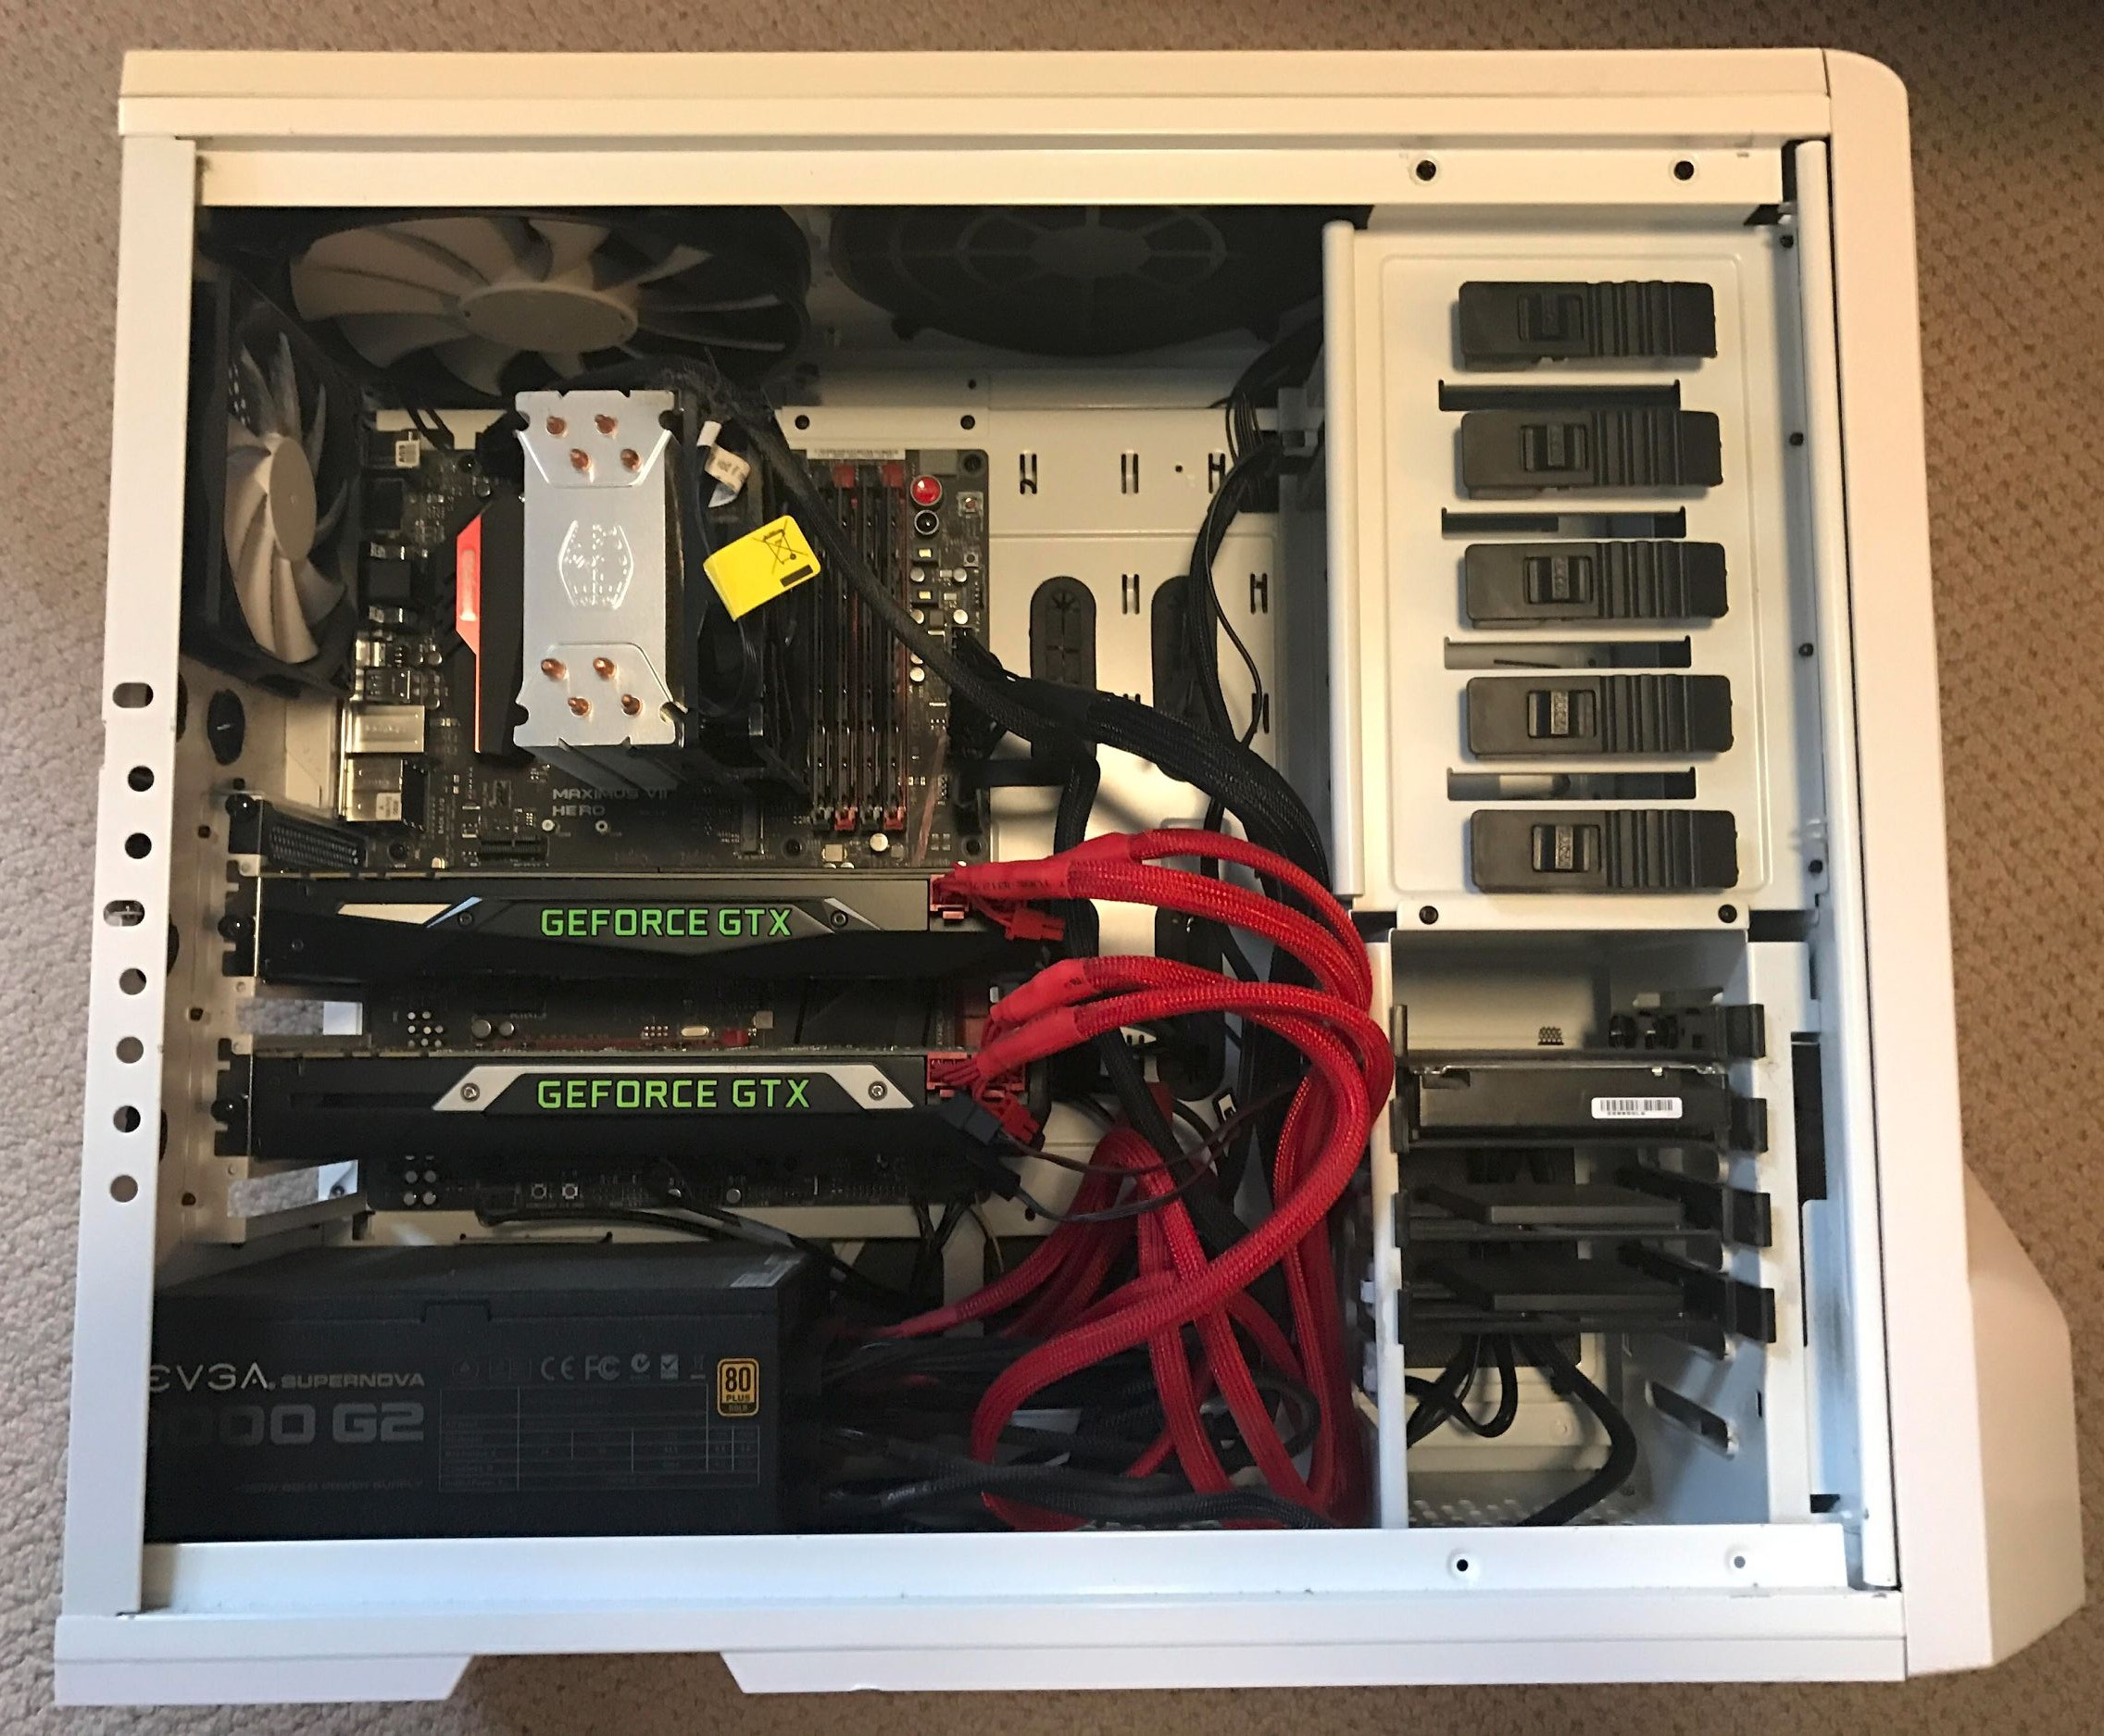
My computer
Lecture 8 -6
6
Notes:
저스틴 존슨의 컴퓨터

Slide 7
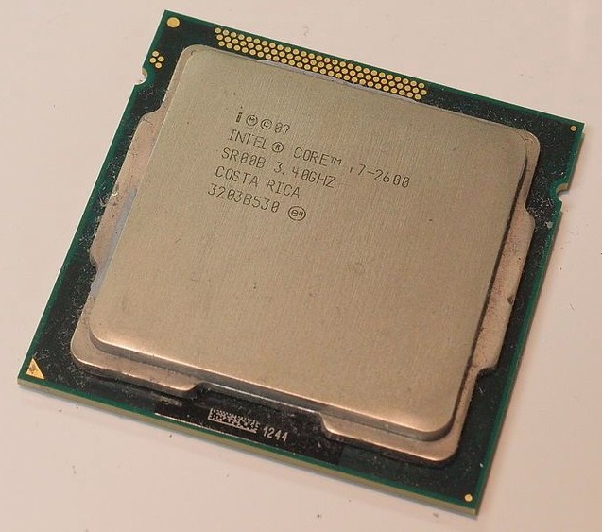
Spot the CPU!
(central processing unit)
This image is licensed under CC-BY 2.0
Lecture 8 -7
7

Slide 8
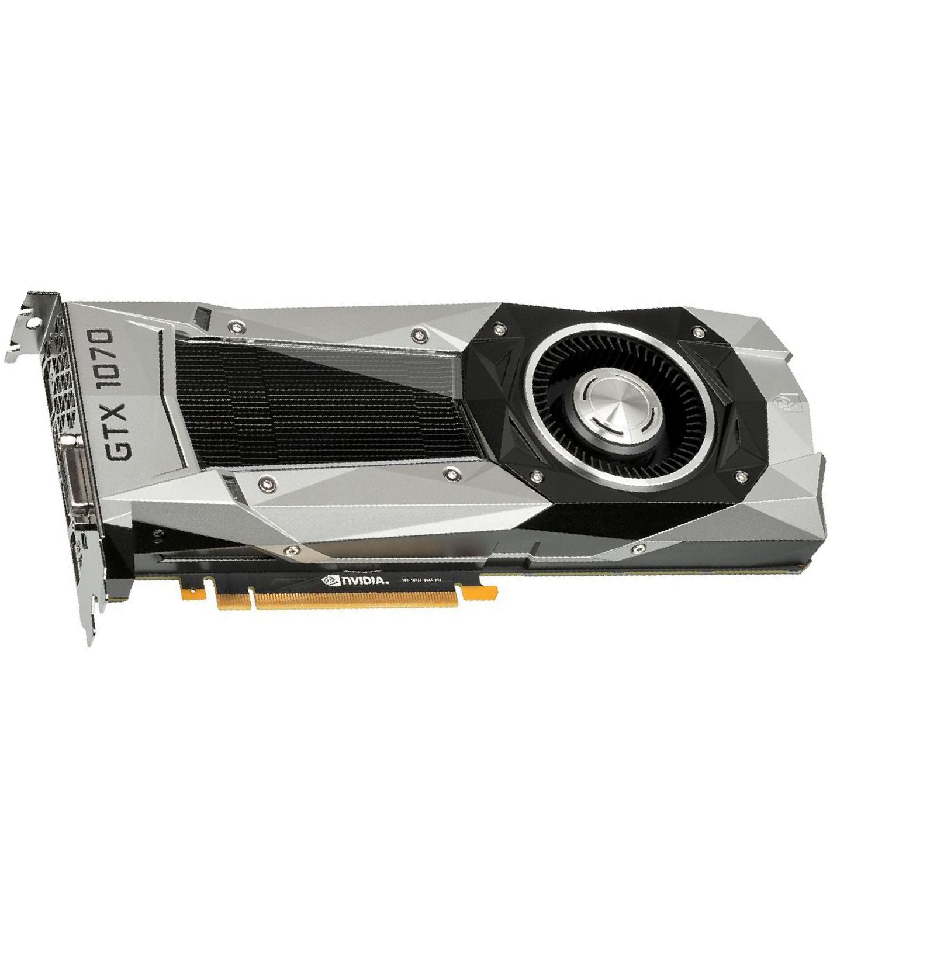
Spot the GPUs!
(graphics processing unit)
This image is in the public domain
Lecture 8 -8
8

Slide 9
NVIDIA
AMD
vs
Lecture 8 -9
9

Slide 10
NVIDIA
AMD
vs
Lecture 8 -1010

Slide 11
CPU vs GPU
 | # Cores | Clock Speed | Memory | Price
CPU (Intel Core i7-7700k) | 4 (8 threads with hyperthreading ) | 4.4 GHz | Shared with system | $339
CPU (Intel Core i7-6950X) | 10 (20 threads with hyperthreading ) | 3.5 GHz | Shared with system | $1723
GPU (NVIDIA Titan Xp) | 3840 | 1.6 GHz | 12 GB GDDR5X | $1200
GPU (NVIDIA GTX 1070) | 1920 | 1.68 GHz | 8 GB GDDR5 | $399
CPU: Fewer cores, but each core is much faster and much more capable; great at sequential tasks
GPU: More cores, but each core is much slower and “dumber”; great for parallel tasks
Lecture 8 -1111

Slide 12




Example: Matrix Multiplication
A x B
A x C
B x C
=
Lecture 8 -1212
Notes:
시퀀셜 구조 CPU 보다 병렬구조인 GPU가 빠름을 알려주는 예시 중 하나로 매트릭스로 함

Slide 13
Programming GPUs
CUDA (NVIDIA only)
Write C-like code that runs directly on the GPU
Higher-level APIs: cuBLAS, cuFFT, cuDNN, etc
OpenCL
Similar to CUDA, but runs on anything
Usually slower :(
Udacity: Intro to Parallel Programming https://www.udacity.com/course/cs344
For deep learning just use existing libraries
Lecture 8 -1313
Notes:
CUDA / OPENCL 비교 자료 찾으면 올리기

Slide 14
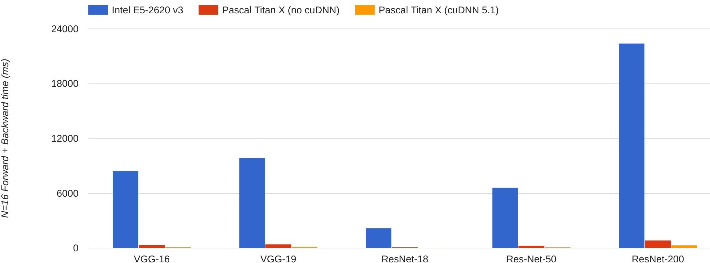



CPU vs GPU in practice
(CPU performance not
well-optimized, a little unfair)
66x
67x 71x 64x
76x
Data from https://github.com/jcjohnson/cnn-benchmarks
Lecture 8 -
14
Fei-Fei Li & Justin Johnson & Serena Yeung Lecture 8 - April 27, 2017
Notes:
Torch 사용

Slide 15
CPU vs GPU in practice
cuDNN much faster than “unoptimized” CUDA
2.8x
3.0x
3.1x
3.4x
2.8x
Data from https://github.com/jcjohnson/cnn-benchmarks
Lecture 8 -
15
Fei-Fei Li & Justin Johnson & Serena Yeung Lecture 8 - April 27, 2017
Notes:
Torch 사용

Slide 16


CPU / GPU Communication
Model is here
Data is here
Lecture 8 -
16
Fei-Fei Li & Justin Johnson & Serena Yeung Lecture 8 - April 27, 2017

Slide 17
CPU / GPU Communication
Model is here
Data is here
If you aren’t careful, training can bottleneck on reading data and transferring to GPU!
Solutions:
Read all data into RAM
Use SSD instead of HDD
Use multiple CPU threads to prefetch data
Lecture 8 -
17
Fei-Fei Li & Justin Johnson & Serena Yeung Lecture 8 - April 27, 2017

Slide 18
Deep Learning Frameworks
Lecture 8 -
18
Fei-Fei Li & Justin Johnson & Serena Yeung Lecture 8 - April 27, 2017
Notes:
Introduction 시작시 질문이 있었으나, 녹음되지 않음 코딩할 때, 설계적으로 CPU <-> GPU 간 communication 문제를 해결하려면 어떻게 하냐고 물었고, 저스틴 존슨은 시퀀셜 구조인 CPU와 병렬구조인 GPU 구조를 잘 이해해서 둘의 유휴시간을 중여야한다고 말함

Slide 19
Last year ...
Caffe
(UC Berkeley)
Torch
(NYU / Facebook)
Theano
(U Montreal)
TensorFlow
(Google)
Lecture 8 -
19
Fei-Fei Li & Justin Johnson & Serena Yeung Lecture 8 - April 27, 2017
Notes:
2016년 강의 기준 Caffe / Torch / Theano -> 텐서플로우를 소개했었으나
2016년 때 텐서플로우가 막대하게 유명해짐

Slide 20
Paddle
(Baidu)
This year ...
Caffe
(UC Berkeley)
Caffe2
(Facebook)
CNTK
(Microsoft)
Torch
(NYU / Facebook)
PyTorch
(Facebook)
MXNet
(Amazon)
Developed by U Washington, CMU, MIT, Hong Kong U, etc but main framework of choice at AWS
Theano
(U Montreal)
TensorFlow
(Google)
And others...
Lecture 8 -
20
Fei-Fei Li & Justin Johnson & Serena Yeung Lecture 8 - April 27, 2017
Notes:
올해는 Caffe -> Caffe2 / Torch -> PyTorch / Theano -> Tensorflow 로 진행할 예정이고, 저스틴 존슨은 Caffe2 / Pytorch 를 연구용으로 사용
나머지 3개는 아직 덜 유명
여기서 볼만한 점은 1세대 Framework은 학술용으로 설계하기 위해 대학에서 생성됬다면, 2세대부터는 기업에서 만듦.
PyTorch / Tensorflow 가 더 유명해짐

Slide 21
Paddle
(Baidu)
Today
A bit about these
Caffe
(UC Berkeley)
Caffe2
(Facebook)
CNTK
(Microsoft)
Torch
(NYU / Facebook)
PyTorch
(Facebook)
MXNet
(Amazon)
Developed by U Washington, CMU, MIT, Hong Kong U, etc but main framework of choice at AWS
Theano
(U Montreal)
TensorFlow
(Google)
Mostly these
And others...
Lecture 8 -
21
Fei-Fei Li & Justin Johnson & Serena Yeung Lecture 8 - April 27, 2017

Slide 22
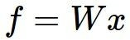
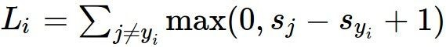
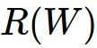
Recall: Computational Graphs
x
*
s (scores)
hinge loss
+
L
W
R
Lecture 8 -
22
Fei-Fei Li & Justin Johnson & Serena Yeung Lecture 8 - April 27, 2017
Notes:
러닝에서 계산하고자 하는 구조를 그래프로 만들때,
Data X 와 Weight W 를 곱한 후 ( score ) hinge loss 적용 하여 loss 계산에 이용함
Regularization Term 이나

Slide 23
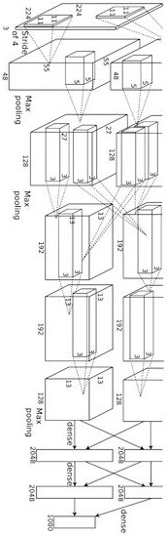
Recall: Computational Graphs
input image
weights loss
Figure copyright Alex Krizhevsky, Ilya Sutskever, and Geoffrey Hinton, 2012. Reproduced with permission.
Lecture 8 -
23
Fei-Fei Li & Justin Johnson & Serena Yeung Lecture 8 - April 27, 2017
Notes:
한눈에 봐도 엄청 복잡해보임

Slide 24
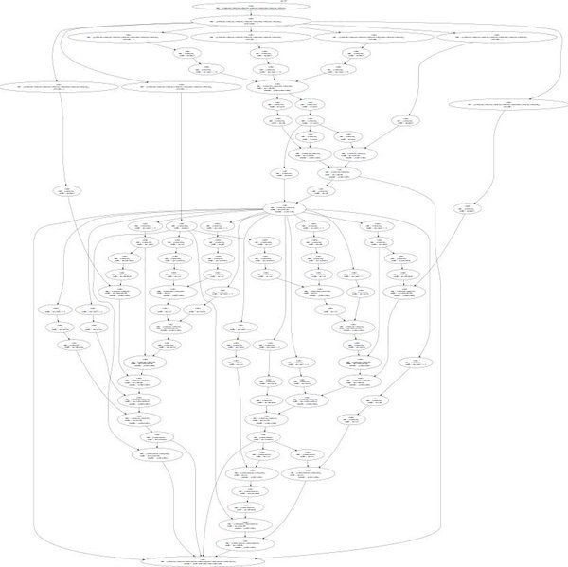
Recall: Computational Graphs
input image
loss
Figure reproduced with permission from a Twitter post by Andrej Karpathy.
Lecture 8 -
24
Fei-Fei Li & Justin Johnson & Serena Yeung Lecture 8 - April 27, 2017
Notes:
한눈에 봐도 엄청 복잡해보임

Slide 25
The point of deep learning frameworks
Easily build big computational graphs
Easily compute gradients in computational graphs
Run it all efficiently on GPU (wrap cuDNN, cuBLAS, etc)
Lecture 8 -2525
Notes:
이러한 Deep Learning framework 을 사용하는 이유는
Big computational graph를 매번 생성해야하고,
매번 gradients 를 계산해서 알아야 하고
Loss 와 Loss 보정용 weight도 알아야하는데, 이러한 것을 자동으로 계산하게 하고, 직접 code로 짤 필요가 없이 라이브러리로 불러와 사용하면 되기 떄문

Slide 26
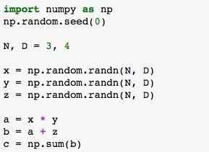
Computational Graphs
Numpy
x y z
*
a
+
b
Σ
c
Lecture 8 -2626

Slide 27
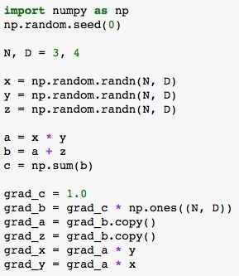
Computational Graphs
Numpy
x y z
*
a
+
b
Σ
c
Lecture 8 -2727

Slide 28
Computational Graphs
Numpy
x y z
*
a
Problems:
+
Can’t run on GPU
Have to compute our own gradients
b
Σ
c
Lecture 8 -2828
Notes:
Gradient 를 계산하기 위해 일일이 계산해줘야함

Slide 29
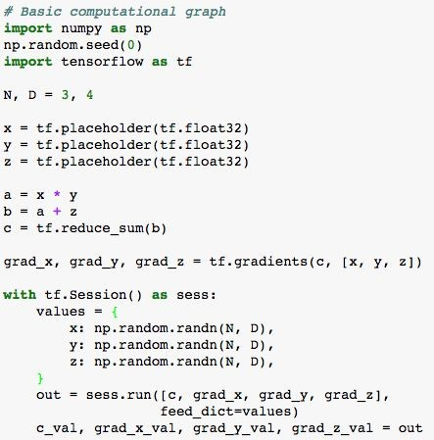
Computational Graphs
TensorFlow
Numpy
x y z
*
a
+
b
Σ
c
Lecture 8 -2929

Slide 30
Computational Graphs
TensorFlow
x y z
*
a
Create forward computational graph
+
b
Σ
c
Lecture 8 -3030

Slide 31
Computational Graphs
TensorFlow
x y z
*
a
+
Ask TensorFlow to
compute gradients
b
Σ
c
Lecture 8 -3131
Notes:
텐서플로우는 gradient 계산식을 제공함 (1.14까지는 tf.gradients 가, 2.0에서는 GradientTape 등을 사용

Slide 32
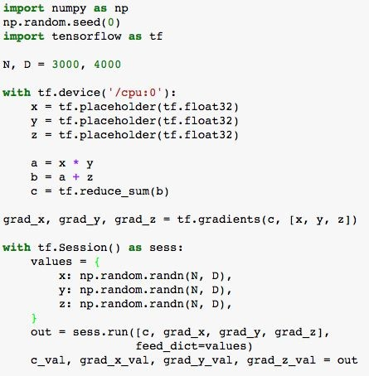
Computational Graphs
TensorFlow
x y z
*
Tell TensorFlow
to run on CPU
a
+
b
Σ
c
Lecture 8 -3232

Slide 33
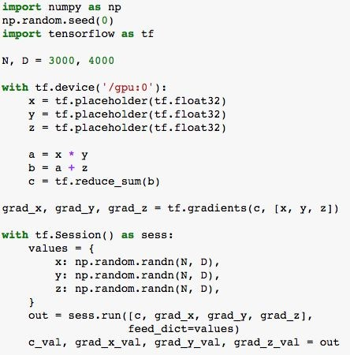
Computational Graphs
TensorFlow
x y z
*
Tell TensorFlow
to run on GPU
a
+
b
Σ
c
Lecture 8 -3333

Slide 34
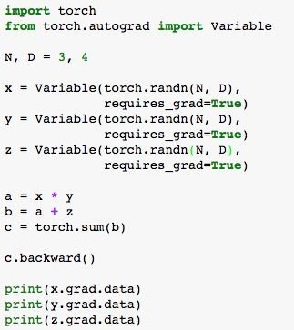
Computational Graphs
PyTorch
x y z
*
a
+
b
Σ
c
Lecture 8 -3434

Slide 35
Computational Graphs
PyTorch
x y z
*
a
Define Variables to
start building a computational graph
+
b
Σ
c
Lecture 8 -3535

Slide 36
Computational Graphs
PyTorch
x y z
*
a
+
b
Forward pass
looks just like numpy
Σ
c
Lecture 8 -3636

Slide 37
Computational Graphs
PyTorch
x y z
*
a
+
b
Σ
Calling c.backward()
computes all gradients
c
Lecture 8 -3737

Slide 38
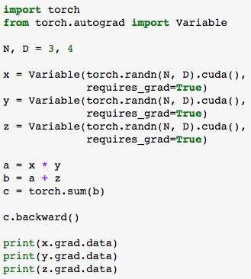
Computational Graphs
PyTorch
x y z
*
Run on GPU by casting to .cuda()
a
+
b
Σ
c
Lecture 8 -3838

Slide 39
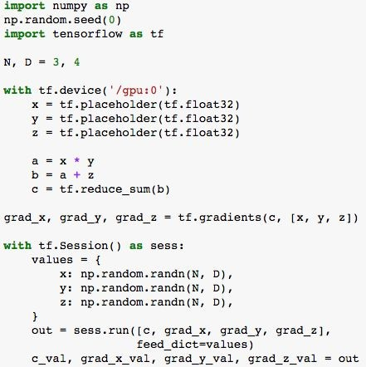
PyTorch
Numpy
TensorFlow
Lecture 8 -3939
Notes:
Numpy 도 좋지만 설명하는 두 framework 의 장점은 GPU 가속과 Gradient 계산을 자동으로 할 수 있는 것에 있음

Slide 40
TensorFlow
(more detail)
Lecture 8 -4040

Slide 41
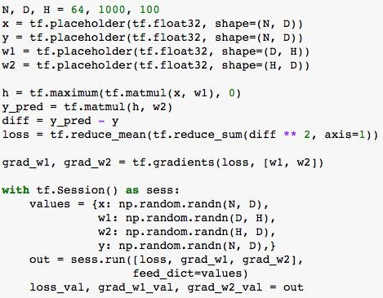
TensorFlow: Neural Net
Running example: Train a two-layer ReLU network on random data with L2 loss
Lecture 8 -4141
Notes:
예제로 2 layer ReLU 를 들음

Slide 42
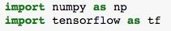
TensorFlow: Neural Net
(Assume imports at the top of each snipppet)
Lecture 8 -4242
Notes:
위 코드에선 빠져있지만, Numpy와 tensorflow를 import 해줘야함

Slide 43
TensorFlow: Neural Net
First define
computational graph
Then run the graph many times
Lecture 8 -4343
Notes:
TensorFlow은 크게 2단계로 , Computational graph 를 정의하는 단계와 / graph를 여러 번 사용하는 단계로 정의할 수있음

Slide 44
TensorFlow: Neural Net
Create placeholders for input x, weights w1 and w2, and targets y
Lecture 8 -4444
Notes:
Graph를 만들기 위해 placeholder를 통해서 각 input / weight / target 를 생성함. 이 3종류는 각각 graph의 input node가 됨 data는 이 node를 통해 graph를 통과함

Slide 45
TensorFlow: Neural Net
Forward pass: compute prediction for y and loss (L2 distance between y and y_pred)
No computation happens here - just building the graph!
Lecture 8 -4545
Notes:
Forward pass 에선 y와 loss 를 구하기 위해 prediction을 계산하고. 위의 계산결과가 여기서 어떠한 일을 하지는 않음
Loss도 간단하게 유클리드 거리만 구함
-> 이 단계는 graph를 만들기 위한 단계일 뿐임

Slide 46
TensorFlow: Neural Net
Tell TensorFlow to compute loss of gradient with respect to w1 and w2.
Again no computation here - just building the graph
Lecture 8 -4646
Notes:
Gradients 를 통해 w1 / w2 gradient를 계산함

Slide 47
TensorFlow: Neural Net
Now done building our graph, so we enter a session so we can actually run the graph
Lecture 8 -4747
Notes:
Graph를 모두 만들었으면, Session 을 통해 graph를 실행 시킬 수있음

Slide 48
TensorFlow: Neural Net
Create numpy arrays that will fill in the placeholders above
Lecture 8 -4848
Notes:
계산을 위해 numpy array를 만들고, placeholder를 통해 생성한 데이터를 넣어줌. 여기에 실제 data를 넣으면 됨

Slide 49
TensorFlow: Neural Net
Run the graph: feed in the numpy arrays for x, y, w1, and w2; get numpy arrays for loss, grad_w1, and grad_w2
Lecture 8 -4949
Notes:
실제 돌아가는 graph // 실제 그래프를 통해 얻을 수 있는 결과를 할당함

Slide 50
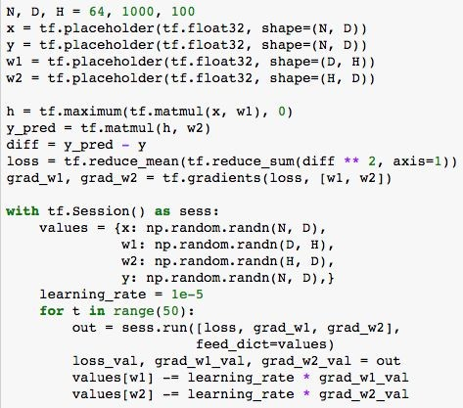
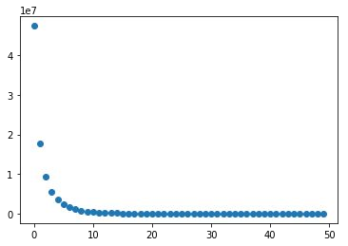
TensorFlow: Neural Net
Train the network: Run the graph over and over, use gradient to update weights
Lecture 8 -5050
Notes:
Train을 원할 시, out을 정의시킬 수 있음

Slide 51
TensorFlow: Neural Net
Problem: copying weights between CPU / GPU each step
Train the network: Run the graph over and over, use gradient to update weights
Lecture 8 -5151
Notes:
매 계산다마 run을 호출함하여 gradient 와 weigh를 update함.
문제는 여기서 numpy array (CPU)와 gradient (GPU) 는 처리 주체가 다르므로 매 step 마다 CPU / GPU 가 같이 update해야함
-> CPU GPU Bottleneck 의 위험이 있음

Slide 52
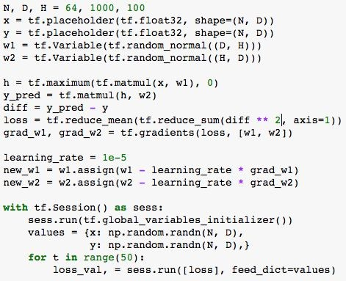
TensorFlow: Neural Net
Change w1 and w2 from placeholder (fed on each call) to Variable (persists in the graph between calls)
Lecture 8 -5252
Notes:
이에 대한 솔루션으로,Variable로 바꿈으로써 해결할 순 있으나 initialize 시점 문제가 있음

Slide 53
TensorFlow: Neural Net
Add assign operations to update w1 and w2 as part of the graph!
Lecture 8 -5353
Notes:
Assign operation을 통해 update 주기를 graph 안에서 설정 가능

Slide 54
TensorFlow: Neural Net
Run graph once to initialize w1 and w2
Run many times to train
Lecture 8 -5454
Notes:
Initializer 를 통해 그래프를 돌릴 때 w1 / w2를 init 가능
그리고 train을 위해 여러 번 돌림

Slide 55
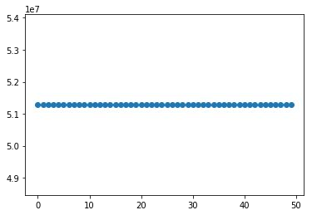
TensorFlow: Neural Net
Problem: loss not going down! Assign calls not actually being executed!
Lecture 8 -5555
Notes:
생길수있는 문제 : Loss가 떨어지지 않고, Assign이 실제로 실행 안되는거 같음 (학생의 가설은 graph 호출시 매번 w가 re-init 되면 저렇게 되지 않을까?)
답은 new_w1 / new_w2의 동작을 명시적으로 해놓을 필요가 있음

Slide 56
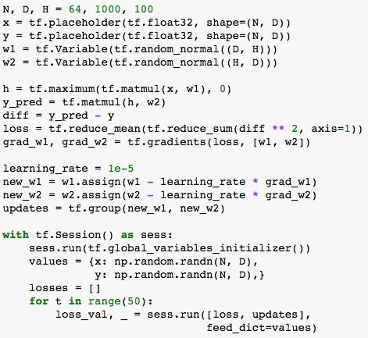

TensorFlow: Neural Net
Add dummy graph node that depends on updates
Tell graph to compute dummy node
Lecture 8 -5656
Notes:
Group 함수를 통해서 묶어서 업데이트 해야함
그래프가 Dummy node를 계산하라고 시켜야함
-> 이경우 GPU / CPU 점유율을 많이 잡아먹게됨
Q) X / Y를 그래프에 넣지 않은 이유?
A) Numpy 처럼 생각하고, 매 iteration 마다 같은 X / Y 를 재사용 했음 실제 활용시 X/Y는 데이터의 minibatch 로 쓰임 (mini batch는 최적화 시간에 배움)

Slide 57
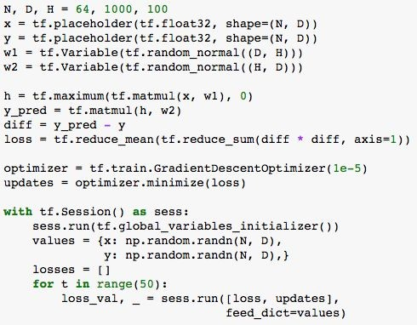
TensorFlow: Optimizer
Can use an optimizer to compute gradients and update weights
Remember to execute the output of the optimizer!
Lecture 8 -5757
Notes:
Gradient / weight 를 계산하는데 최적화를 해주는 optimizer 를 사용할 수 있음

Slide 58
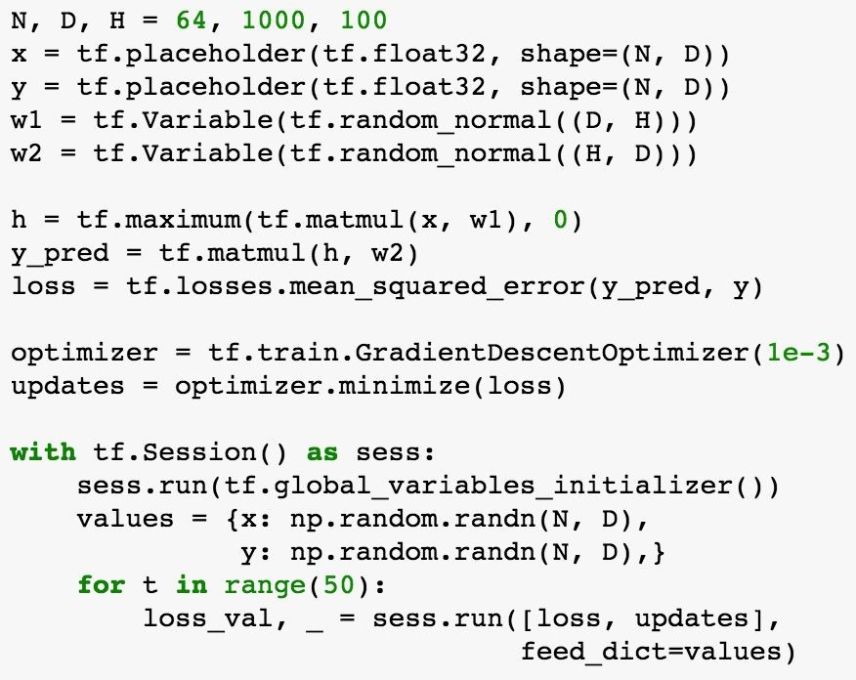
TensorFlow: Loss
Use predefined common lossees
Lecture 8 -5858
Notes:
Loss의 경우, predefine 된 loss를 사용할 수도 있음

Slide 59
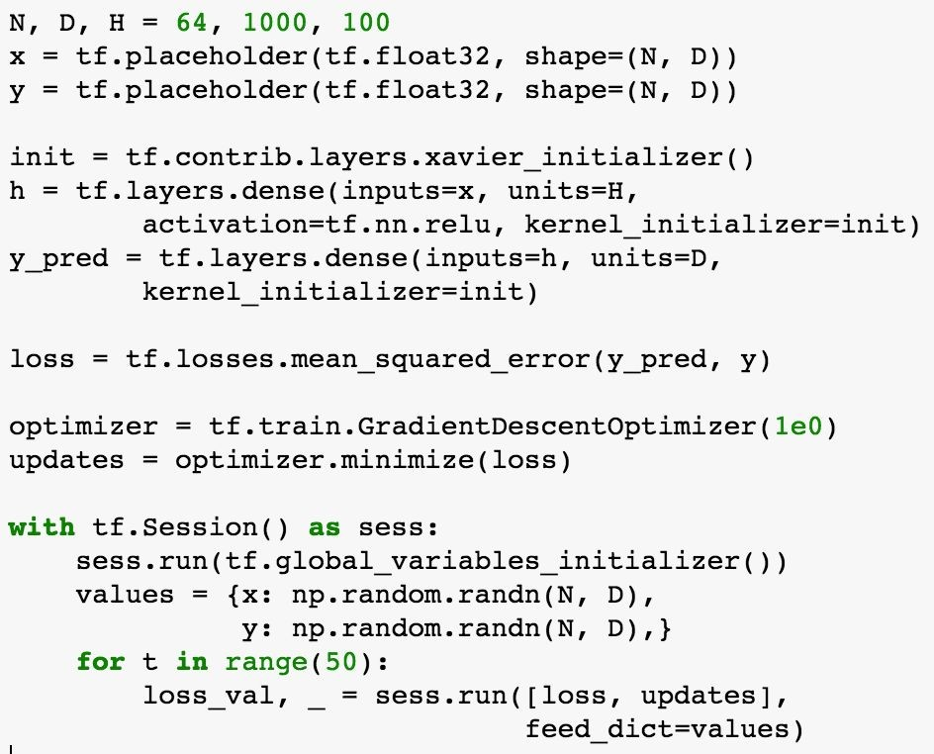
TensorFlow: Layers
Use Xavier initializer
tf.layers automatically sets up weight and (and bias) for us!
Lecture 8 -5959
Notes:
Xavier initializer object를 통해서 Layer화 하는 예시를 들어줌.
Weight 와 Gradiant 등을 자동으로 셋팅해 줄 수 있음

Slide 60
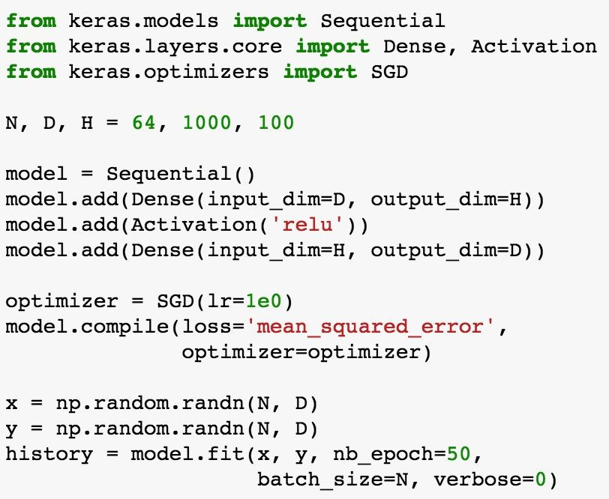
Keras: High-Level Wrapper
Keras is a layer on top of TensorFlow, makes common things easy to do
(Also supports Theano backend)
Lecture 8 -6060
Notes:
이러한 Layer 의 예제로 자주 쓰이는 High Level Wrapper 로 Keras 설명
Computational Graph 생성을 매우 쉽게 만들어줌

Slide 61
Keras: High-Level Wrapper
Define model object as a sequence of layers
Lecture 8 -6161
Notes:
Model 정의를 Layer 정의하는 것 처럼 할 수 있게 만듦

Slide 62
Keras: High-Level Wrapper
Define optimizer object
Lecture 8 -6262
Notes:
Optimizer도 간단히 정의할 수 있음

Slide 63
Keras: High-Level Wrapper
Build the model, specify loss function
Lecture 8 -6363
Notes:
이렇게 정의한 Model을 Loss function을 정의해줌과 동시에 build 가능

Slide 64
Keras: High-Level Wrapper
Train the model with a single line!
Lecture 8 -6464
Notes:
전체 Training 과정을 fit 한줄로 완성 시킬 수 있음

Slide 65
TensorFlow: Other High-Level
Wrappers
Keras (https://keras.io/)
TFLearn (http://tflearn.org/)
TensorLayer (http://tensorlayer.readthedocs.io/en/latest/)
tf.layers (https://www.tensorflow.org/api_docs/python/tf/layers)
TF-Slim (https://github.com/tensorflow/models/tree/master/inception/inception/slim)
tf.contrib.learn (https://www.tensorflow.org/get_started/tflearn)
Pretty Tensor (https://github.com/google/prettytensor)
Lecture 8 -6565

Slide 66
TensorFlow: Other High-Level
Wrappers
Ships with TensorFlow
Keras (https://keras.io/)
TFLearn (http://tflearn.org/)
TensorLayer (http://tensorlayer.readthedocs.io/en/latest/)
tf.layers (https://www.tensorflow.org/api_docs/python/tf/layers)
TF-Slim (https://github.com/tensorflow/models/tree/master/inception/inception/slim)
tf.contrib.learn (https://www.tensorflow.org/get_started/tflearn)
Pretty Tensor (https://github.com/google/prettytensor)
Lecture 8 -6666

Slide 67
TensorFlow: Other High-Level
Wrappers
Ships with TensorFlow
Keras (https://keras.io/)
TFLearn (http://tflearn.org/)
From Google
TensorLayer (http://tensorlayer.readthedocs.io/en/latest/)
tf.layers (https://www.tensorflow.org/api_docs/python/tf/layers)
TF-Slim (https://github.com/tensorflow/models/tree/master/inception/inception/slim)
tf.contrib.learn (https://www.tensorflow.org/get_started/tflearn)
Pretty Tensor (https://github.com/google/prettytensor)
Lecture 8 -6767

Slide 68
TensorFlow: Other High-Level
Wrappers
Ships with TensorFlow
Keras (https://keras.io/)
TFLearn (http://tflearn.org/)
From Google
TensorLayer (http://tensorlayer.readthedocs.io/en/latest/)
tf.layers (https://www.tensorflow.org/api_docs/python/tf/layers) TF-Slim (https://github.com/tensorflow/models/tree/master/inception/inception/slim) tf.contrib.learn (https://www.tensorflow.org/get_started/tflearn)
Pretty Tensor (https://github.com/google/prettytensor)
Sonnet (https://github.com/deepmind/sonnet)
From DeepMind
Lecture 8 -6868

Slide 69
TensorFlow: Pretrained Models
Transfer Learning
 | FC-C
 | FC-4096
 | FC-4096
Reinitialize this and train
MaxPool
Conv-512
Conv-512
TF-Slim: (https://github.com/tensorflow/models/tree/master/slim/nets)
Keras: (https://github.com/fchollet/deep-learning-models)
MaxPool
Conv-512
Conv-512
MaxPool
Conv-256
Conv-256
Freeze these
MaxPool
Conv-128
Conv-128
MaxPool
Conv-64
Conv-64
Image
Lecture 8 -6969

Slide 70
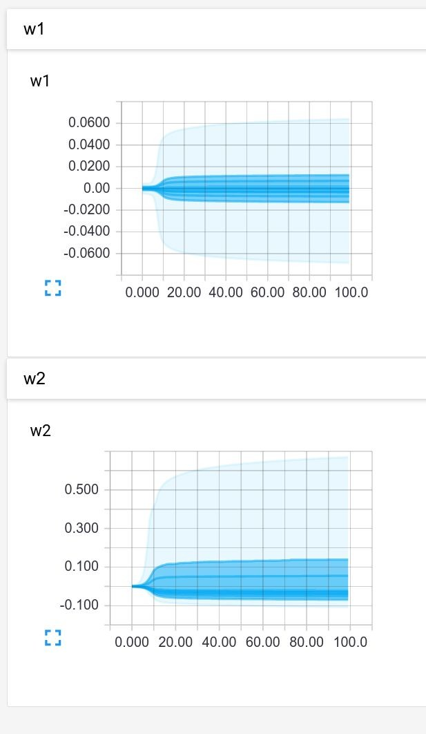
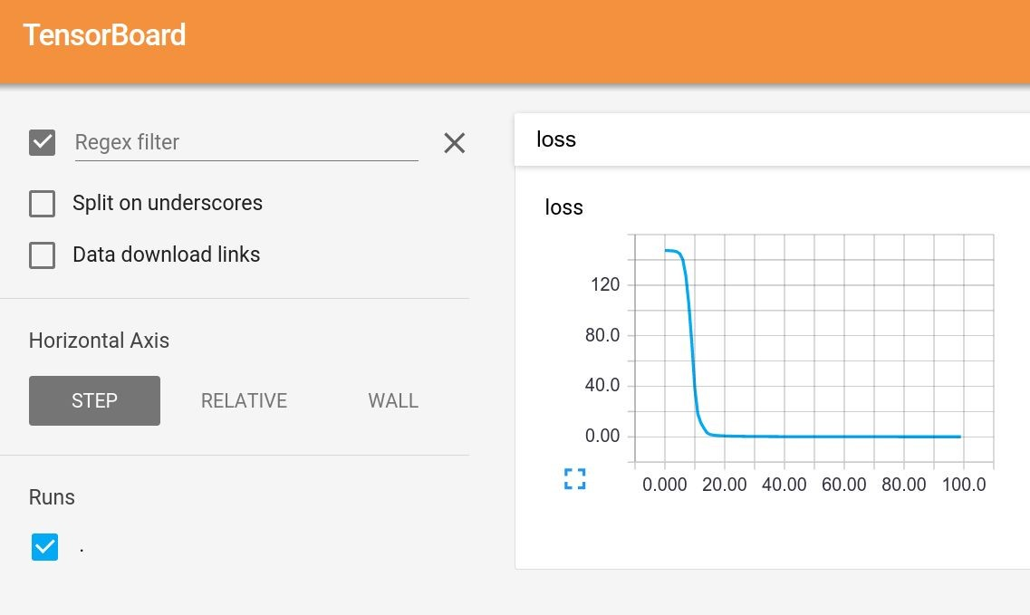
TensorFlow: Tensorboard
Add logging to code to record loss, stats, etc Run server and get pretty graphs!
Lecture 8 -
70
Notes:
Training Process나, Loss 기록 / Graph 확인 등을 할 수있는 좋은 Visualization Tool로 TensorBoard를 소개함

Slide 71



TensorFlow: Distributed Version
Split one graph over multiple machines!
https://www.tensorflow.org/deploy/distributed
Lecture 8 -
71
Notes:
더 나아가면 각 Network의 일부를 각 Machine에 할당하여 계산시킬 수 있음

Slide 72
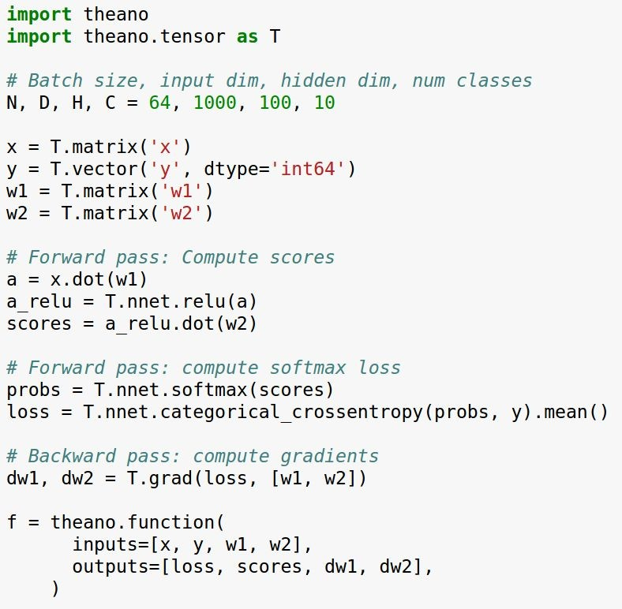
Side Note: Theano
TensorFlow is similar in many ways to Theano (earlier framework from Montreal)
Lecture 8 -
72
Notes:
Tensorflow의 원형인 Theano 를 잠깐 언급 -> 몬트리얼 대학에서 최초로 만듦

Slide 73
Side Note: Theano
Define symbolic variables (similar to TensorFlow placeholder)
Lecture 8 -
73
Notes:
전반적인 구조가 Tensorflow의 원형인 만큼 Tensorflow와 유사함

Slide 74
Side Note: Theano
Forward pass: compute predictions and loss
Lecture 8 -
74

Slide 75
Side Note: Theano
Forward pass: compute predictions and loss
(no computation performed yet)
Lecture 8 -
75

Slide 76
Side Note: Theano
Ask Theano to compute
gradients for us
(no computation performed yet)
Lecture 8 -
76

Slide 77
Side Note: Theano
Compile a function that computes loss, scores, and gradients from data and weights
Lecture 8 -
77

Slide 78
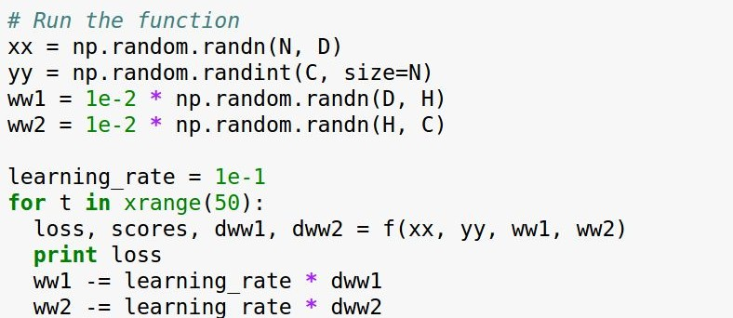
Side Note: Theano
Run the function many times to train the network
Lecture 8 -
78

Slide 79
PyTorch
(Facebook)
Lecture 8 -7979

Slide 80
PyTorch: Three Levels of Abstraction
Tensor: Imperative ndarray, but runs on GPU
Variable: Node in a computational graph; stores data and gradient
Module: A neural network layer; may store state or learnable weights
Lecture 8 -8080
Notes:
3종류 Layer로 Abstraction Level이 이루어짐
Tensor : Imperative Numpy data Array (ndarray)
딥러닝에 관련되서 아무것도 모르는 데이터 -> 하지만 GPU 위에서 돌아감
Pytorch 에서는 이 Tensor를 Computational graph 를 만들기 위한 Computational graph의 node 로 사용하여 gradient 계산을 할 수 있게 해줌

Slide 81
PyTorch: Three Levels of Abstraction
TensorFlow equivalent
Numpy array
Tensor, Variable, Placeholder
tf.layers, or TFSlim, or TFLearn, or Sonnet, or ….
Tensor: Imperative ndarray, but runs on GPU
Variable: Node in a computational graph; stores data and gradient
Module: A neural network layer; may store state or learnable weights
Lecture 8 -8181
Notes:
Tensorflow 와 비교시
Tensor와 Numpy array
--
Variable과 Tensor / variable / placeholder 등 (Computational graph의 모든 종류의 node 에 해당)
--
Module 과 tf.layer / TFSlim / TFLearn 등과 대응함 (Higher level frameworks 에 해당)
-> 고로 high level abstraction 이 같이 들어가므로 괜찮다 생각하는 nnmodule만 불러오면 사용할 수 있다.

Slide 82
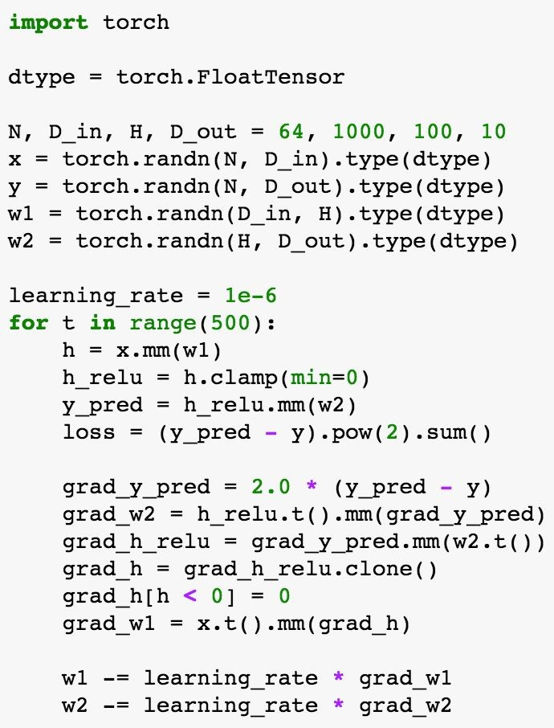
PyTorch: Tensors
PyTorch Tensors are just like numpy arrays, but they can run on GPU.
No built-in notion of computational graph, or gradients, or deep learning.
Here we fit a two-layer net using PyTorch Tensors:
Lecture 8 -8282
Notes:
본 코드에서는 pytorch tensor 만 사용해서 2 layer network를 만들었는데, 여기서 주목할 점은 numpy를 import할 필요가 없어짐, Tensor가 그 기능을 지원함

Slide 83
PyTorch: Tensors
Create random tensors for data and weights
Lecture 8 -8383
Notes:
위에 코드는 Assignment 1때 numpy로 구성한 2 Layer code

Slide 84
PyTorch: Tensors
Forward pass: compute predictions and loss
Lecture 8 -8484
Notes:
Forward pass 를 위해 계산식 작성

Slide 85
PyTorch: Tensors
Backward pass: manually compute gradients
Lecture 8 -8585
Notes:
명시적으로 Backward pass를 보기 위해 Homework 때와 같이 manually 계산

Slide 86
PyTorch: Tensors
Gradient descent step on weights
Lecture 8 -8686
Notes:
Learning rate와 계산된 Gradient를 이용하여 weight를 계산
Numpy array와 pytorch array 다른점은 GPU 위에서 동작이 가능함 (애초에 numpy기능을 넣어서 만들려고 한게 pytorch)

Slide 87
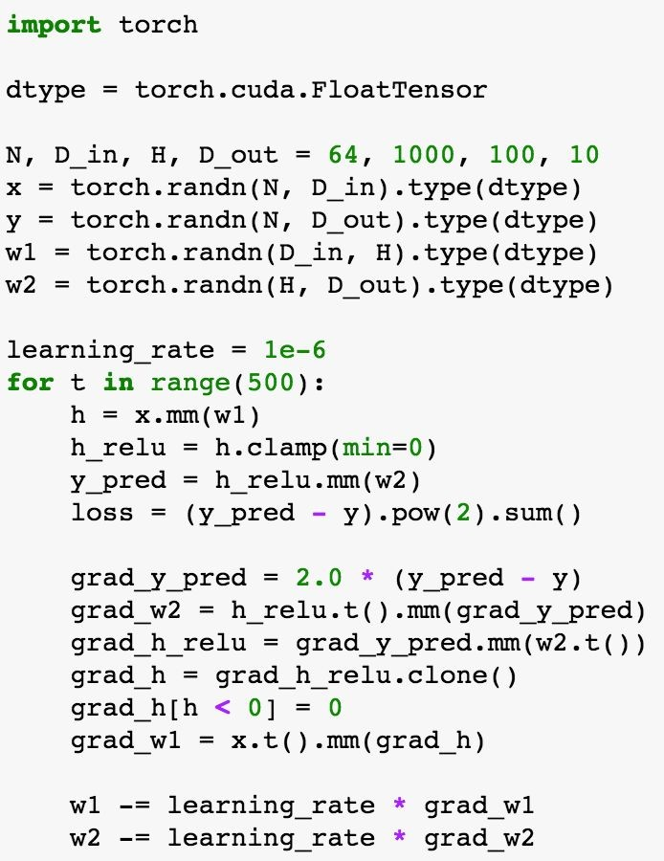
PyTorch: Tensors
To run on GPU, just cast tensors to a cuda datatype!
Lecture 8 -8787
Notes:
GPU 사용시 datatype에 casting 만 하면 됨
CPU : torch.FloatTensor
GPU : torch.cuda.FloatTensor (Nvidia Only)
보다시피 pyTorch 를 Numpy + GPU func 이라 생각하면됨

Slide 88
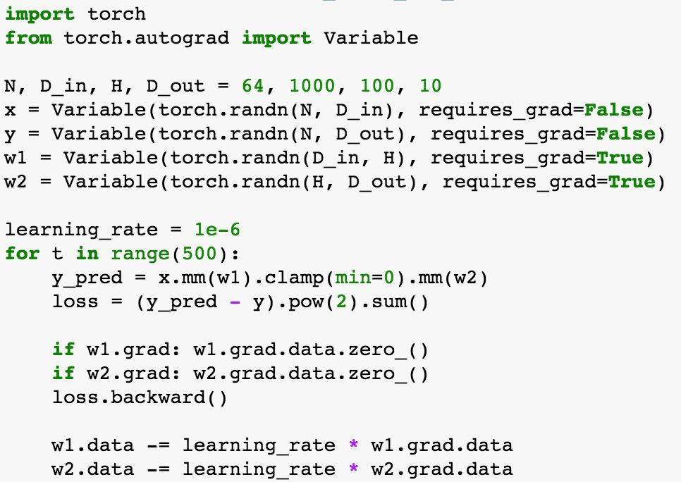
PyTorch: Autograd
A PyTorch Variable is a node in a computational graph
x.data is a Tensor
x.grad is a Variable of gradients (same shape as x.data)
x.grad.data is a Tensor of gradients
Lecture 8 -8888
Notes:
Pytorch의 다음 abstraction layer는 variable 임
X 를 variabl로 둘때,
x.Data 는 Tensor ,
x.Grad 는 loss 의 gradient 를 포함하는 variable
x.grad.data는 실제 gradien를 가지는 tensor

Slide 89
PyTorch: Autograd
PyTorch Tensors and Variables have the same API!
Variables remember how they were created (for backprop)
Lecture 8 -8989
Notes:
Variable 안에 Tensor 내용이 포함되는 만큼 같은 API 를 사용함
즉, 실제로는 Tensor layer만 사용해도 동작 함.
Variable은 실제 computational graph를 직접 만들때나 사용하면 됨

Slide 90
PyTorch: Autograd
We will not want gradients (of loss) with respect to data
Do want gradients with respect to weights
Lecture 8 -9090
Notes:
Gradient 계산을 원할시 flag 설정만으로 계산된 데이터를 받아올 수 있음

Slide 91
PyTorch: Autograd
Forward pass looks exactly
the same as the Tensor version, but everything is a variable now
Lecture 8 -9191
Notes:
Tensor layer와 동일하게 코드가 작성되있으나, Variable로 동작함

Slide 92
PyTorch: Autograd
Forward pass looks exactly
the same as the Tensor version, but everything is a variable now
Lecture 8 -9191
Notes:
Tensor layer와 동일하게 코드가 작성되있으나, Variable로 동작함

Slide 93
PyTorch: Autograd
https://discuss.pytorch.org/t/why-do-we-need-to-set-the-gradients-manually-to-zero-in-pytorch/4903
Compute gradient of loss
with respect to w1 and w2 (zero out grads first)
Lecture 8 -9292
Notes:
Grad.data.zero를 쓰는 이유는 variable이 backpropagation 도중 gradient 누적이 되는데, 이전 계산들이 영향이 끼치지 않게 zero로 바꿔줌
W1과 w2의 값을 찾기 위해 Loss.backward 계산

Slide 94
PyTorch: Autograd
Make gradient
step on weights
Lecture 8 -9393
Notes:
이후 learning rate와 gradient 를 이용하여 weight 업데이트함
Numpy 과 같은 과정에 gradient 계산만 덤으로 들어옴
Tensorflow와 차이점은 tensor는 graph를 명시적으로 만들어 나가야하지만,
Pytorch에서는 매번 forward pass에서 새 graph를 만들어나감
그래서 좀 더 빠르게 만들수있음

Slide 95
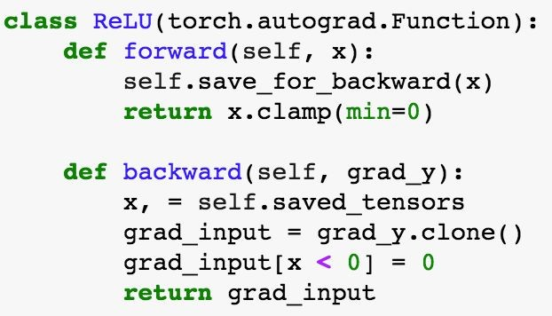
PyTorch: New Autograd Functions
Define your own autograd functions by writing forward and backward for Tensors
(similar to modular layers in A2)
Lecture 8 -9494
Notes:
또한 forward / backward를 직접 설계할 수도 있음.
직접 만든 autograd function을 computational graph에 반영 가능

Slide 96
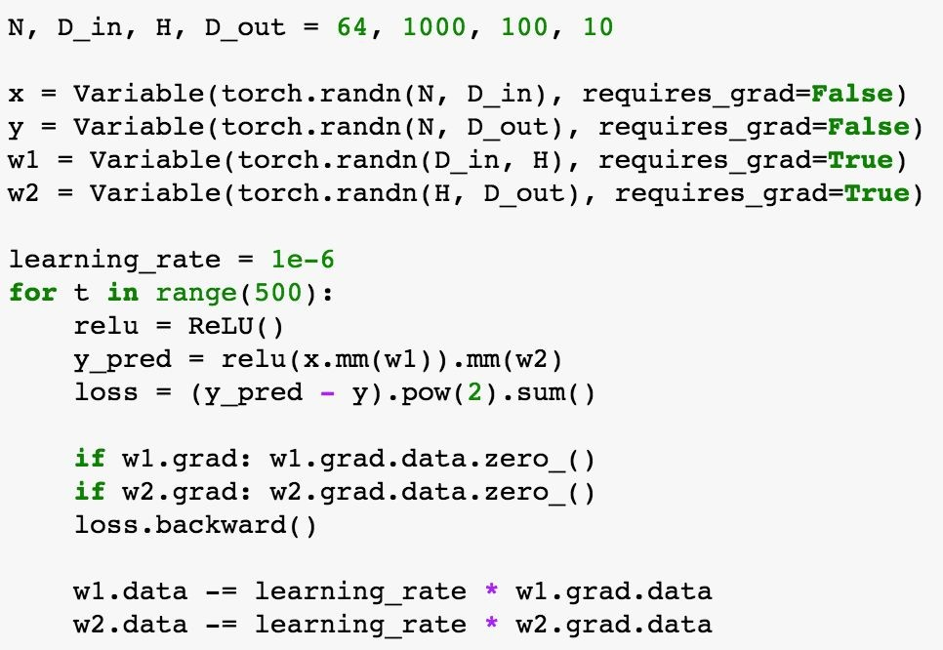
PyTorch: New Autograd Functions
Can use our new autograd function in the forward pass
Lecture 8 -9595
Notes:
본 예제에선 ReLU를 새로 만들어서 적용함 이런식으로 실제 user가 원하는 만큼 implement 해서 적용할 수 있다.

Slide 97
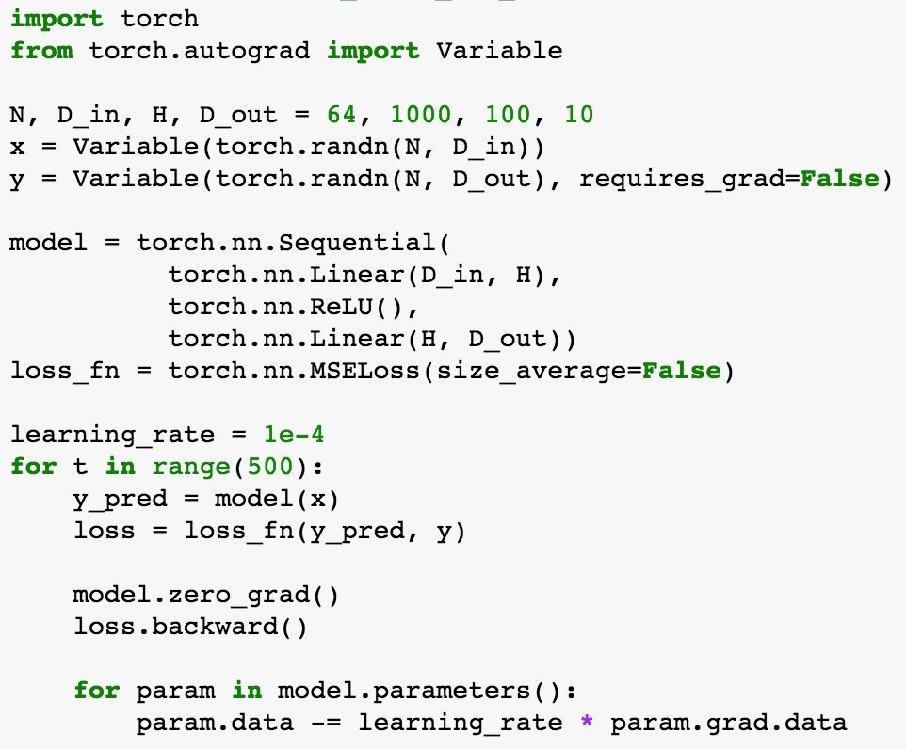
PyTorch: nn
Higher-level wrapper for working with neural nets
Similar to Keras and friends … but only one, and it’s good =)
Lecture 8 -9696
Notes:
Tensor나 Keras 처럼 High Level wrapper를 쓸수있음
여기서는 pytorch.nn package를 예시로 들음

Slide 98
PyTorch: nn
Define our model as a
sequence of layers
nn also defines common loss functions
Lecture 8 -9797
Notes:
Keras 예제처럼 model을 정의함 package 내 일반적인 loss function 도 적용되어 있어 사용할 수 있음

Slide 99
PyTorch: nn
Forward pass: feed data
to model, and prediction to loss function
Lecture 8 -9898
Notes:
매 iteration 마다 data 를 가져와 prediction / loss function 을 가져올 수 있음

Slide 100
PyTorch: nn
Backward pass: compute all gradients
Lecture 8 -9999
Notes:
Loss.backward 를 통해 gradient를 모두 계산

Slide 101
PyTorch: nn
Make gradient step on
each model parameter
10
Fei-Fei Li & Justin Johnson & Serena Yeung
Lecture 8 - 100
April 27, 2017
0
Notes:
Model parameter 마다 grad data및 learning rate를 이용하여 model을 update함

Slide 102
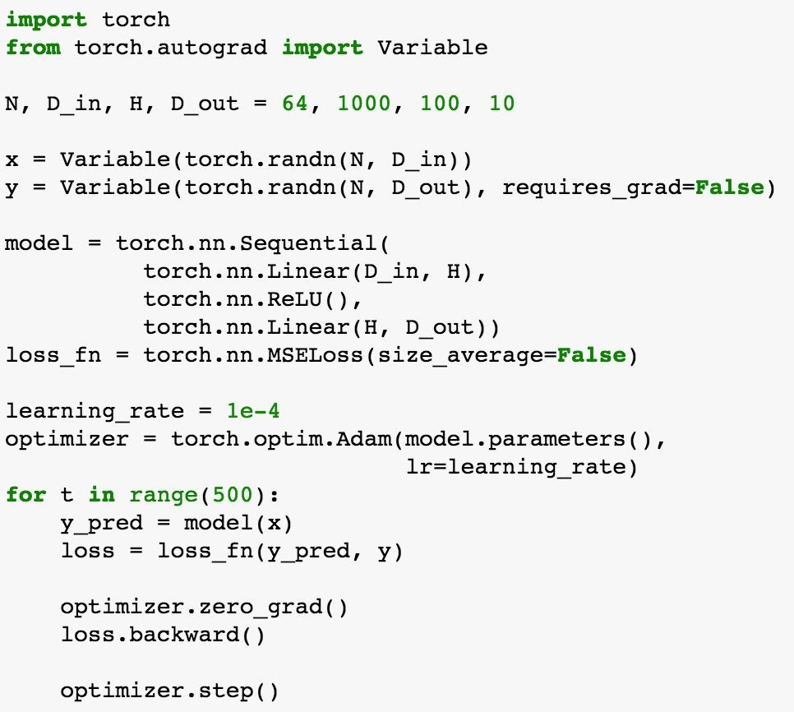
PyTorch: optim
Use an optimizer for
different update rules
10
Fei-Fei Li & Justin Johnson & Serena Yeung
Lecture 8 - 101
April 27, 2017
1
Notes:
Pytorch 또한 optimization 기능을 제공함 예제에서는 Adam과 같은 update rule을 사용함

Slide 103
PyTorch: optim
Update all parameters after computing gradients
10
Lecture 8 - 102
2
Notes:
Optimizing 후에 step을 적용하여 parameter를 업데이트함

Slide 104
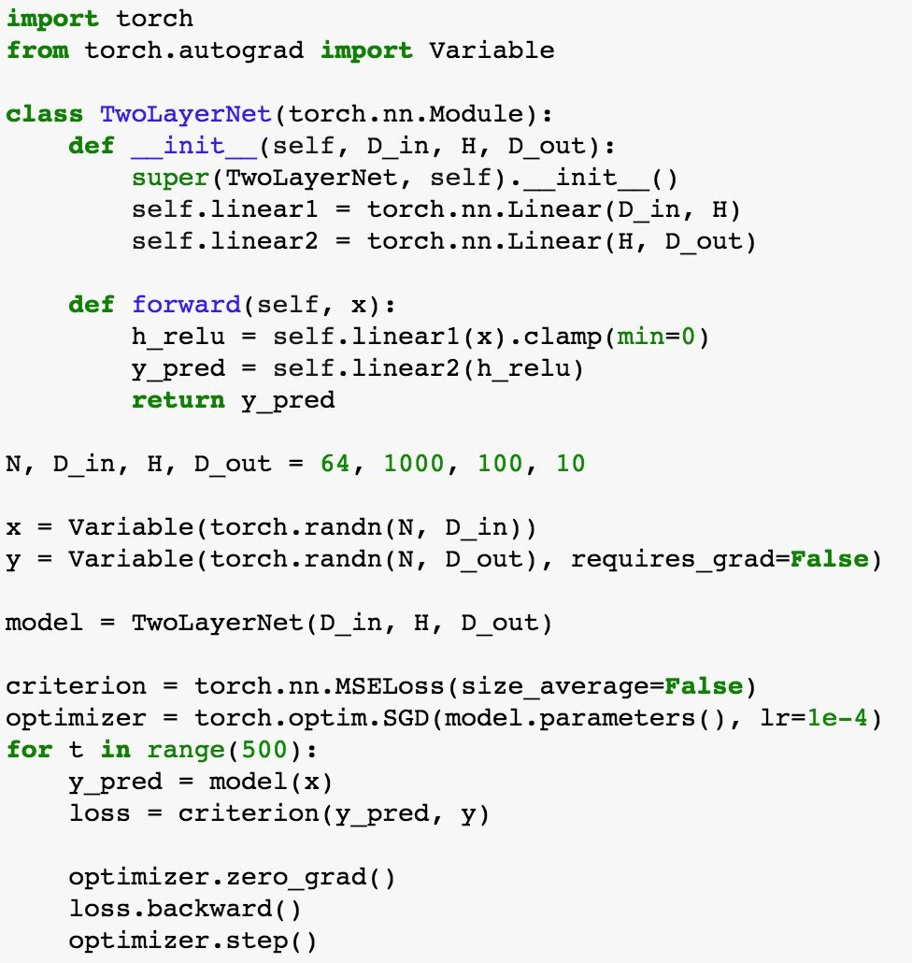
PyTorch: nn
Define new Modules
A PyTorch Module is a neural net layer; it inputs and outputs Variables
Modules can contain weights (as Variables) or other Modules
You can define your own Modules using autograd!
10
Lecture 8 - 103
3
Notes:
새로운 NN을 만들 수도 있음. Module이라는 layer로 만들어서 input / output variable만 주면 됨

Slide 105
PyTorch: nn
Define new Modules
Define our whole model as a single Module
10
Lecture 8 - 104
4
Notes:
직접 만든 model을 single module로서 정의하면 됨

Slide 106
PyTorch: nn
Define new Modules
Initializer sets up two children (Modules can contain modules)
10
Lecture 8 - 105
5
Notes:
Init 때 in / out 을 주지만, module을 포함시켜도 됨

Slide 107
PyTorch: nn
Define new Modules
Define forward pass using child modules and autograd ops on Variables
No need to define backward - autograd will handle it
10
Lecture 8 - 106
6
Notes:
NN 속에 각종 functio을 넣을 수 있는데, 여기서는 Autograd 의 보조 기능으로서 forward를 새로 정의함 각 input은 variable로 동작시키게함
Backward는 autogard 로 다룸

Slide 108
PyTorch: nn
Define new Modules
Construct and train an instance of our model
10
Lecture 8 - 107
7
Notes:
아래 코드는 train 과정인데, 위의 variable / optimization 설명때와 동일함

Slide 109
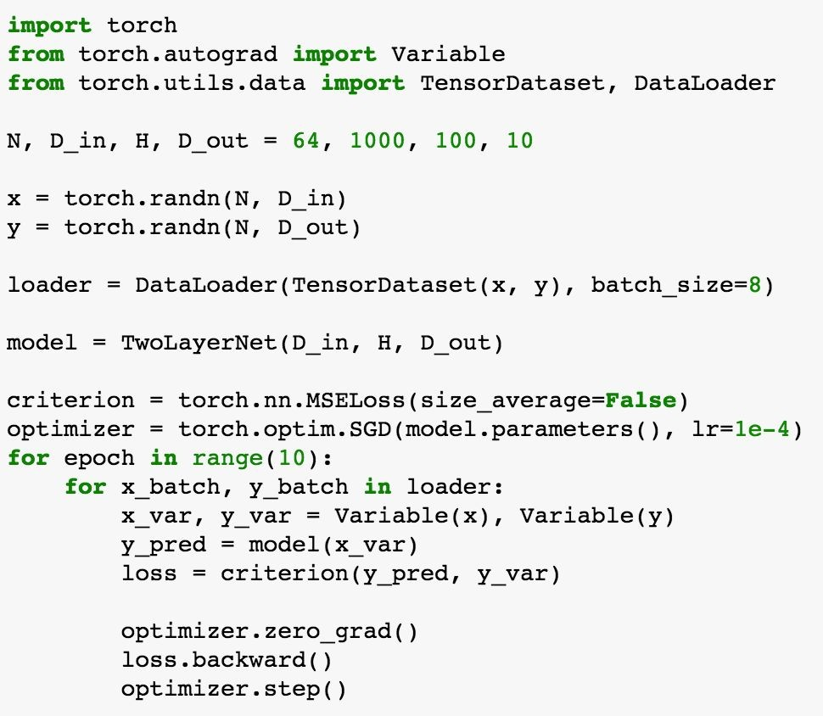
PyTorch: DataLoaders
A DataLoader wraps a Dataset and provides minibatching, shuffling, multithreading, for you
When you need to load custom data, just write your own Dataset class
10
Lecture 8 - 108
8
Notes:
Dataset을 불러올 때 DataLoader를 이용하여 불러올 수 있고 / minibatching / multithreading 등에 사용가능하게 함. Dataset 을 불러올때 TensorDataset 자리에 사용하면됨

Slide 110
PyTorch: DataLoaders
Iterate over loader to form minibatches
Loader gives Tensors so you need to wrap in Variables
10
Lecture 8 - 109
9
Notes:
각자 다른 Dataset들을 Dataloader를 통해 abstraction 하여 iteration 마다 minibatch를 시켜서 tensor 처럼 만들어 줄 수 있음.

Slide 111
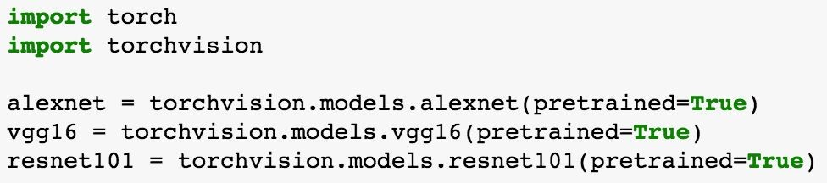
PyTorch: Pretrained Models
Super easy to use pretrained models with torchvision https://github.com/pytorch/vision
11
Lecture 8 - 110
0
Notes:
Justin johnson 이 추천하는 pretrained model
Torchvision

Slide 112
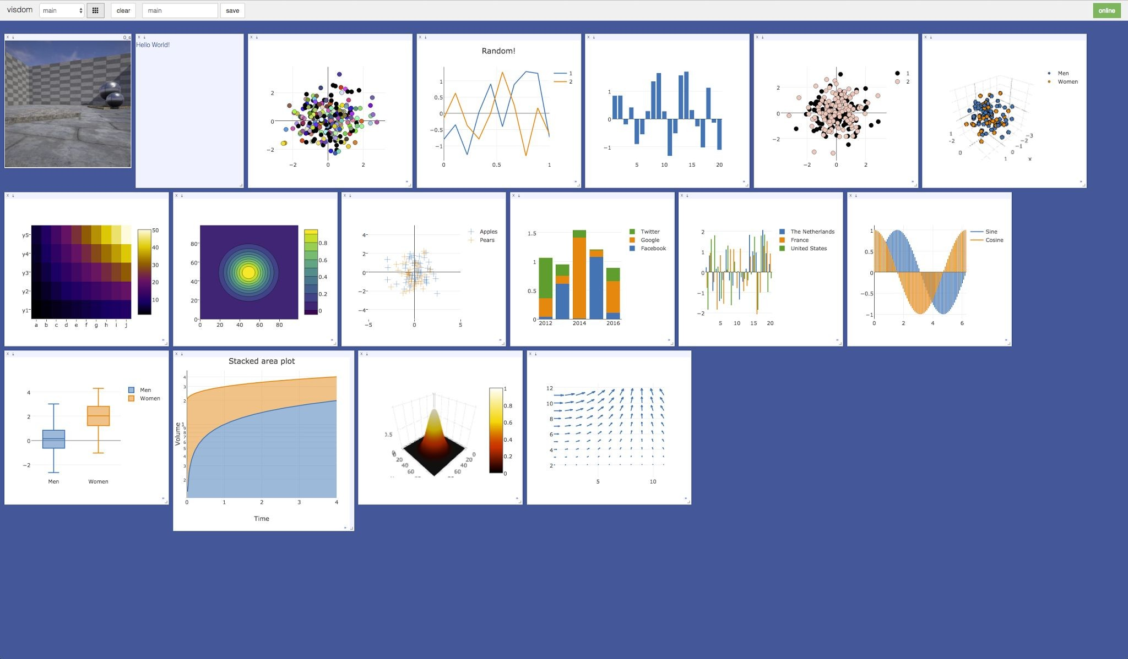
PyTorch: Visdom
Somewhat similar to TensorBoard: add logging to your code, then visualized in a browser
Can’t visualize computational graph structure (yet?)
https://github.com/facebookresearch/visdom
This image is licensed under CC-BY 4.0; no changes were made to the image
Notes:
페이스북 연구팀이 공개한 Visdom은 TensorBoard 처럼 loss staticstics 같은 것을 볼 수있으나 justin은 사용해볼 기회가 없었음 TensorBoard 는 Computational Graph를 제공하나 Visdom은 없어서 아쉬움

Slide 113
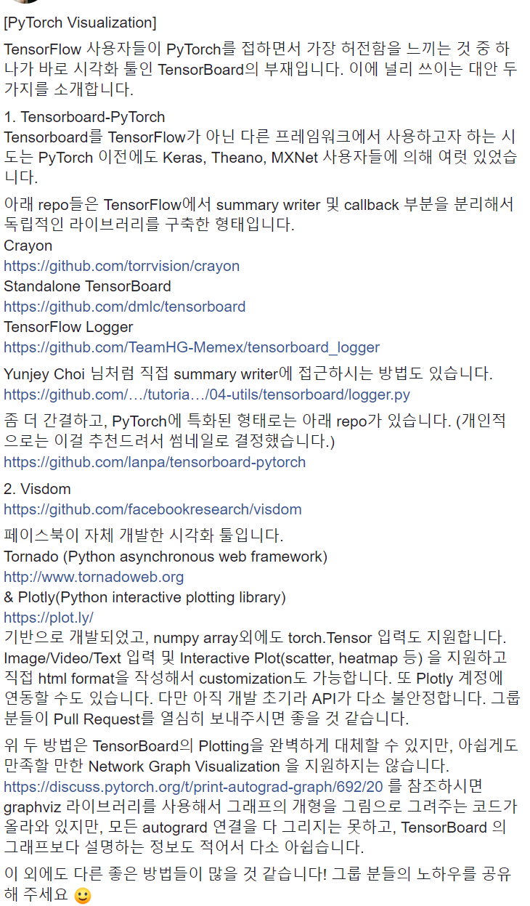
PyTorch: Visdom
Somewhat similar to TensorBoard: add logging to your code, then visualized in a browser
Can’t visualize computational graph structure (yet?)
https://www.facebook.com/groups/PyTorchKR/permalink/936746803131668/
This image is licensed under CC-BY 4.0; no changes were made to the image
Notes:
파이토치 KR 글 인용

Slide 114
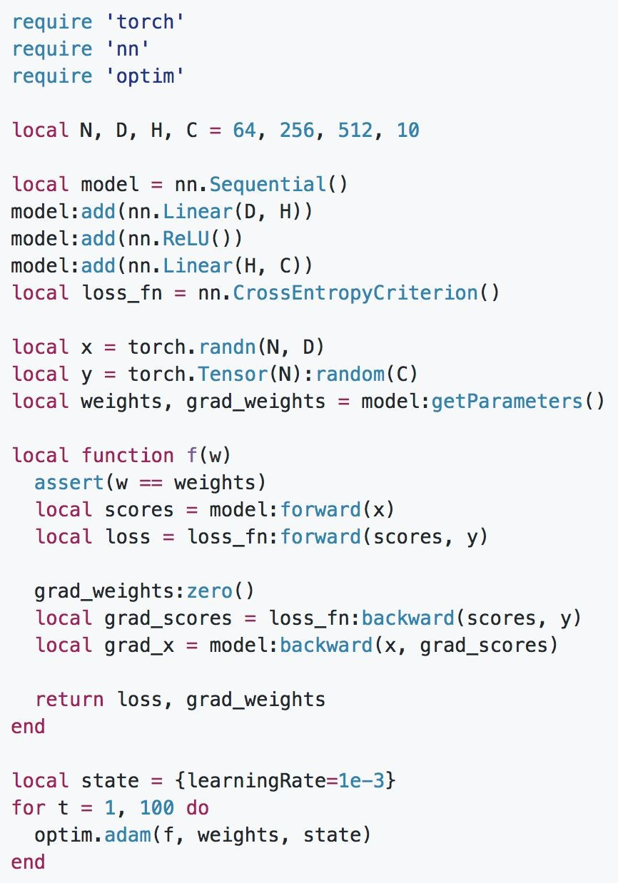
Aside: Torch
Direct ancestor of PyTorch (they share a lot of C backend)
Written in Lua, not Python
PyTorch has 3 levels of abstraction: Tensor, Variable, and Module
Torch only has 2: Tensor, Module
More details: Check 2016 slides
Notes:
PyTorch 의 원형인 Torch 간단한 리뷰
Lua 언어 기반 (보통 게임에서 사용)
Torch는 Tensor / Module abstraction level을 가짐 (Pytroch 는 Tensor / Variable / Module)
자세한건 2016년껄 참고하고,

Slide 115
Aside: Torch
Build a model as a sequence of layers, and a loss function
Notes:
Pytorch와 유사한 구조를 가짐

Slide 116
Aside: Torch
Define a callback that inputs weights, produces loss and gradient on weights
Notes:
기본적인 구조는 pytorch와 비슷함

Slide 117
Aside: Torch
Forward: compute scores and loss

Slide 118
Aside: Torch
Backward: compute gradient
(no autograd, need to pass grad_scores around)
Notes:
대신 AutoGrad 기능이 없음

Slide 119
Aside: Torch
Pass callback to optimizer over and over

Slide 120
Torch vs PyTorch
Torch
(-) Lua
(-) No autograd (+) More stable
(+) Lots of existing code
(0) Fast
PyTorch
(+) Python (+) Autograd
(-) Newer, still changing (-) Less existing code
(0) Fast
Notes:
Torch 와 Pytorch와 간단 비교

Slide 121
Torch vs PyTorch
Torch
(-) Lua
(-) No autograd (+) More stable
(+) Lots of existing code
(0) Fast
PyTorch
(+) Python (+) Autograd
(-) Newer, still changing (-) Less existing code
(0) Fast
Conclusion: Probably use PyTorch for new projects
Notes:
결론 : Pytorch 써라

Slide 122
Static vs Dynamic Graphs
TensorFlow: Build graph once, then run many times (static)
PyTorch: Each forward pass defines a new graph (dynamic)
Build graph
Run each iteration
New graph each iteration
12
Fei-Fei Li & Justin Johnson & Serena Yeung
Lecture 8 - 120
April 27, 2017
0
Notes:
Tensor 와 PyTorch 차이점 분석
Tensor는 Computational Graph를 한번 만들면 iteration 마다 재사용함 (Static)
PyTorch 는 iteration 단계에서 Computational Graph를 매번 만듦 (Dynamic)
실제 과정은 비슷하나 이정도 차이가 있음

Slide 123


Static vs Dynamic: Optimization
With static graphs, framework can optimize the graph for you before it runs!
The graph you wrote
Equivalent graph with
fused operations
Conv
ReLU
Conv
ReLU
Conv
ReLU
Conv+ReLU
Conv+ReLU
Conv+ReLU
Notes:
Static Graph에선, 실행전에 framework에서 graph를 최적화 시킬 수 있음 (같은 graph를 재사용하니 가능함)
1번 최적화에는 시간이 걸려도 , 반복하면서 좀 더 효울적이게 할 수있음

Slide 124
Static vs Dynamic: Serialization
Static
Once graph is built, can serialize it and run it without the code that built the graph!
Dynamic
Graph building and execution are intertwined, so always need to keep code around
Notes:
Serialization 단계에선
Static Graph는 만들어 진 후 graph를 만드는 코드 없이 바로 돌릴 수 있으나 = 생략 가능,
Dynamic graph는 building / execution 이 같이 일어나서 original code를 유지해야함
-> Visualization Tool 부재를 Graph 의 차이로 이해하면 빠를 듯

Slide 125
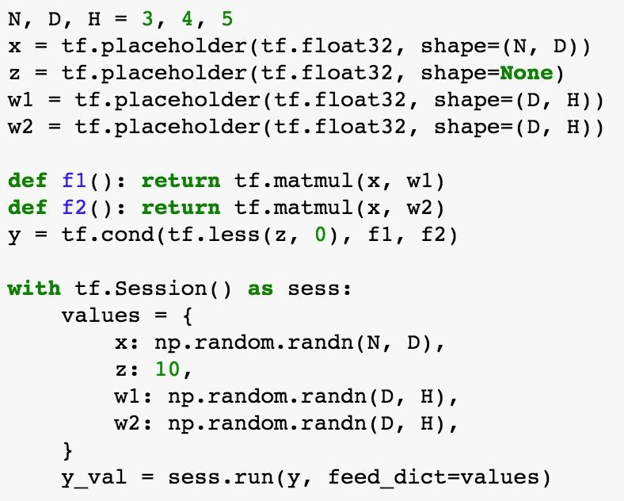
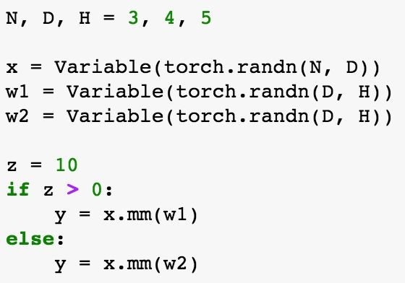

Static vs Dynamic: Conditional
TensorFlow: Special TF
w1 * x w2 * x
if z > 0 otherwise
y =
control flow operator!
PyTorch: Normal Python
12
Lecture 8 - 125
5
Notes:
위와 같은 y에서 w1 / w2에 들어가는 조건을 바꾸고 싶을때,
pyTorch는 조건을 바로 바꾸면됨 = 쉬움 (= graph를 매번 만들기 때문)
Tensorflow는 control flow operator를 사용해야함

Slide 126
Static vs Dynamic: Loops
w
y_{t} = (y_{t-1}+ x_{t}) * w
y₀
+
*
+
*
+
*
x₁
x₂
x₃
12
Lecture 8 - 126
6

Slide 127

Static vs Dynamic: Loops
w
y_{t} = (y_{t-1}+ x_{t}) * w
PyTorch: Normal Python
y₀
+
*
+
*
+
*
x₁
x₂
x₃
12
Lecture 8 - 127
7
Notes:
Loop 에서도 PyTorch는 누적을 위해 [y0]처럼 만들면 됨

Slide 128

Static vs Dynamic: Loops
TensorFlow: Special TF control flow
y_{t} = (y_{t-1}+ x_{t}) * w
PyTorch: Normal Python
12
Lecture 8 - 128
8
Notes:
TensorFlow는 fold 를 통해서 Loop를 위한 Graph 생성 과정을 만들어 줘야함

Slide 129
Dynamic Graphs in TensorFlow
TensorFlow Fold make dynamic graphs easier in TensorFlow through dynamic batching
Looks et al, “Deep Learning with Dynamic Computation Graphs”, ICLR 2017 https://github.com/tensorflow/fold
Notes:
그렇다고 Tensor 가 Static 만 쓸수있는건 아님

Slide 130

Dynamic Graph Applications
- Recurrent networks
Karpathy and Fei-Fei, “Deep Visual-Semantic Alignments for Generating Image Descriptions”, CVPR 2015
Figure copyright IEEE, 2015. Reproduced for educational purposes.
Notes:
당시 ICLR과 겹쳐서 상세 내용은 못들었다고함
Recurrent Network 등에서 dynamic graph 생성

Slide 131




Dynamic Graph Applications
Recurrent networks
Recursive networks
The cat ate a big rat
Notes:
예제로 Recursive Network 에서도 사용가능함

Slide 132

Dynamic Graph Applications
white
Recurrent networks
Recursive networks
Modular Networks
query[color]
What color is the cat?
find[cat]
Andreas et al, “Neural Module Networks”, CVPR 2016
Andreas et al, “Learning to Compose Neural Networks for Question Answering”, NAACL 2016
This image is in the public domain
Notes:
여러 Network 가 섞인 Modular Network 에서도 사용 가능 (색상 / 종류)

Slide 133
Dynamic Graph Applications
no
compare
count |  | count
find[cat] |  | find[dog]
Recurrent networks
Recursive networks
Modular Networks
Are there more cats than dogs?
Andreas et al, “Neural Module Networks”, CVPR 2016
Andreas et al, “Learning to Compose Neural Networks for Question Answering”, NAACL 2016
This image is in the public domain
Notes:
여러 Network 가 섞인 Modular Network 에서도 사용 가능 (개 + 개 마릿수 / 고양이+ 고양이 마릿수 / 개 > 고양이?)

Slide 134
Dynamic Graph Applications
Recurrent networks
Recursive networks
Modular Networks
(Your creative idea here)
Lecture 8 - 134
Notes:
다른 idea에도 적용 가능하니 공부할것

Slide 135
Caffe
(UC Berkeley)
13
Fei-Fei Li & Justin Johnson & Serena Yeung
Lecture 8 - 135
April 27, 2017
5

Slide 136
Caffe Overview
Core written in C++
Has Python and MATLAB bindings
Good for training or finetuning feedforward classification models
Often no need to write code!
Not used as much in research anymore, still popular for deploying models
13
Fei-Fei Li & Justin Johnson & Serena Yeung
Lecture 8 - 136
April 27, 2017
6
Notes:
다음과 같은 이유로 만들어짐.

Slide 137
Caffe: Training / Finetuning
No need to write code!
Convert data (run a script)
Define net (edit prototxt)
Define solver (edit prototxt)
Train (with pretrained weights) (run a script)
Fei-Fei Li & Justin Johnson & Serena Yeung Lecture 8 - April 27, 2017
Notes:
Training 과 Tuning 과정

Slide 138
Caffe step 1: Convert Data
DataLayer reading from LMDB is the easiest
Create LMDB using convert_imageset
Need text file where each line is
“[path/to/image.jpeg] [label]”
Create HDF5 file yourself using h5py
Fei-Fei Li & Justin Johnson & Serena Yeung Lecture 8 - April 27, 2017
Notes:
LMDB / HDF5 필요

Slide 139
Caffe step 1: Convert Data
ImageDataLayer: Read from image files
WindowDataLayer: For detection
HDF5Layer: Read from HDF5 file
From memory, using Python interface
All of these are harder to use (except Python)
Fei-Fei Li & Justin Johnson & Serena Yeung Lecture 8 - April 27, 2017
Notes:
보시다 시피 코딩할 내용이 없음

Slide 140


Caffe step 2: Define Network (prototxt)
Fei-Fei Li & Justin Johnson & Serena Yeung Lecture 8 - April 27, 2017
Notes:
Prototxt 파일을 통해 설정을 만들 수 있음

Slide 141


Caffe step 2: Define Network (prototxt)
Layers and Blobs often have same name!
Number of output classes
Set these to 0 to freeze a layer
Learning rates
(weight + bias)
Regularization (weight + bias)
Fei-Fei Li & Justin Johnson & Serena Yeung
Lecture 8 - April 27, 2017
Notes:
Blobs : 바이너리 라지 오브젝트

Slide 142


Caffe step 2: Define Network (prototxt)
.prototxt can get ugly for big models
ResNet-152 prototxt is 6775 lines long!
Not “compositional”; can’t easily define a residual block and reuse
https://github.com/KaimingHe/deep-residual-networks/blob/master/prototxt/ResNet-152-deploy.prototxt
Fei-Fei Li & Justin Johnson & Serena Yeung Lecture 8 - April 27, 2017
Notes:
안쓰는 사유 : 너무 길어짐 txt 파일로만 6775 라인씀 그리고 재사용하기도 어려움

Slide 143

Caffe step 3: Define Solver (prototxt)
Write a prototxt file defining a SolverParameter
If finetuning, copy existing solver.prototxt file
Change net to be your net
Change snapshot_prefix to your output
Reduce base learning rate (divide by 100)
Maybe change max_iter and snapshot
Fei-Fei Li & Justin Johnson & Serena Yeung Lecture 8 - April 27, 2017
Notes:
Solver parameter로 튜닝하는 방법

Slide 144
Caffe step 4: Train!
./build/tools/caffe train \
-gpu 0 \
-model path/to/trainval.prototxt \
-solver path/to/solver.prototxt \
-weights path/to/pretrained_weights.caffemodel
https://github.com/BVLC/caffe/blob/master/tools/caffe.cpp
Fei-Fei Li & Justin Johnson & Serena Yeung Lecture 8 - April 27, 2017
Notes:
위와 같은 명령어로 트레이닝

Slide 145
Caffe step 4: Train!
./build/tools/caffe train \
-gpu 0 \
-model path/to/trainval.prototxt \
-solver path/to/solver.prototxt \
-weights path/to/pretrained_weights.caffemodel
-gpu -1 for CPU-only
-gpu all for multi-gpu
https://github.com/BVLC/caffe/blob/master/tools/caffe.cpp
Fei-Fei Li & Justin Johnson & Serena Yeung Lecture 8 - April 27, 2017
Notes:
CPU / GPU 선택 가능

Slide 146

Caffe Model Zoo
AlexNet, VGG, GoogLeNet, ResNet, plus others
https://github.com/BVLC/caffe/wiki/Model-Zoo
Fei-Fei Li & Justin Johnson & Serena Yeung Lecture 8 - April 27, 2017
Notes:
이미 Train 된 Model 들을 볼 수 있음

Slide 147
Caffe Python Interface
Not much documentation…
Read the code! Two most important files:
caffe/python/caffe/_caffe.cpp:
Exports Blob, Layer, Net, and Solver classes
caffe/python/caffe/pycaffe.py
Adds extra methods to Net class
Fei-Fei Li & Justin Johnson & Serena Yeung Lecture 8 - April 27, 2017
Notes:
만약 Caffe python을 보려면 이걸 참조

Slide 148
Caffe Python Interface
Good for:
Interfacing with numpy
Extract features: Run net forward
Compute gradients: Run net backward (DeepDream, etc)
Define layers in Python with numpy (CPU only)
Fei-Fei Li & Justin Johnson & Serena Yeung Lecture 8 - April 27, 2017
Notes:
Caffe Python 장점

Slide 149
Caffe Pros / Cons
(+) Good for feedforward networks
(+) Good for finetuning existing networks
(+) Train models without writing any code!
(+) Python interface is pretty useful!
(+) Can deploy without Python
(-) Need to write C++ / CUDA for new GPU layers
(-) Not good for recurrent networks
(-) Cumbersome for big networks (GoogLeNet, ResNet)
Fei-Fei Li & Justin Johnson & Serena Yeung Lecture 8 - April 27, 2017
Notes:
장단점

Slide 150
Caffe2
(Facebook)
14
Fei-Fei Li & Justin Johnson & Serena Yeung
Lecture 8 - 149
April 27, 2017
9

Slide 151
Caffe2 Overview
Very new - released a week ago =)
Static graphs, somewhat similar to TensorFlow
Core written in C++
Nice Python interface
Can train model in Python, then serialize and deploy without Python
Works on iOS / Android, etc
Notes:
Facebook에서 개선시킴. 2017년 Release 되서 당시에 정보가 적음
Core 는 C++ / Python interface로 작성됨

Slide 152



Google: TensorFlow
Facebook: PyTorch +Caffe2
“One framework to rule them all”
Research
Production
Notes:
Caffe2의 개념은 Pytorch로 연구한 NN 을 Production 용으로 쓰기 위해서 만듦.
Tensorflow 는 이를 하나로 합치기 위해서 씀
-> 2019 현재 Pytorch도 one framework으로 변경됨

Slide 153
My Advice:
TensorFlow is a safe bet for most projects. Not perfect but has huge community, wide usage. Maybe pair with high-level wrapper (Keras, Sonnet, etc)
I think PyTorch is best for research. However still new, there can be rough patches.
Use TensorFlow for one graph over many machines
Consider Caffe, Caffe2, or TensorFlow for production deployment Consider TensorFlow or Caffe2 for mobile

Slide 154
Next Time:
CNN Architecture Case Studies

Slide 155

Appendix
Caffe -> Caffe 2
PyTorch v1.0 이후로 PyTorch로 통합됨 (2018/10) [https://caffe2.ai/blog/2018/05/02/Caffe2_PyTorch_1_0.html]
Notes:
참고하면 좋을거 같은 자료

Slide 156

Appendix
TensorFlow vs PyTorch
2019 Arxiv 기준 PyTorch 사용 논문이 더 많아짐 [https://www.oreilly.com/ideas/one-simple-graphic-researchers-love-pytorch-and-tensorflow]
Notes:
참고하면 좋을거 같은 자료

Slide 157
Appendix
TensorFlow
TensorFlow Example GitHub [https://github.com/aymericdamien/TensorFlow-Examples]
PyTorch
PyTorch Tutorial GitHub [https://github.com/yunjey/pytorch-tutorial]
Autograd [https://pytorch.org/tutorials/beginner/blitz/autograd_tutorial.html]
Notes:
참고하면 좋을거 같은 자료

Slide 158
Q&A?
Notes:
질문?

